Slide 1

Protected Mode Operation

Slide 2
Outline
Overview
Real vs Protected Mode
Descriptors
Segmentation
Paging
Data Structures

Slide 3
Overview
Protected mode operation is for multi-user multi-tasking environment
Protects data and code between different users, tasks and operating system
Allows for 4 different privilege levels 0 to 3, 0 being the highest, usually allocated to OS Core or Kernel
Some instructions can be executed only in 0 level: HLT, IN, OUT and memory management

Slide 4
Real vs Protected Mode operation
REAL MODE | PROTECTED MODE
Single user single task | Multi user multi task
Effective address | Logical address
Physical address | Linear address
64 KB segments fixed size | Up to 4GB variable length segments
Segment registers | Descriptors and descriptor tables
Physical Memory | Virtual memory
No privilege levels | 4 privilege levels

Slide 5
Descriptors are data structures that describe a segment

Slide 6
Attributes stored in a descriptor
The base address in memory (32-bit)
The limit (20-bit), expressed either in 4K or 1-byte units
Control bits: the Granularity bit (limit’s unit), Present bit (useful when swapping between RAM or Page file on HDD), and two protection bits DPL, Privilege Level
The descriptor type, one of the 16 supported, among them: executable, read-only code segment; data segment; stack segment; call, trap, or interrupt gate; task state segment, and others

Slide 7
Segment Register’s new role
Segment registers are selectors (indexes) into either the GDT or the LDT (the IDT entries are only used when an interrupt is raised). A selector (such as a segment register) contains a 13-bit index, a 1-bit table identification (GDT/LDT), and a 2-bit protection level.
GDT Global Descriptor Table 1 per System
LDT Local Descriptor Table 1 per Task; 0, 1 ore many present but only 1 active at any given time

Slide 8
Addressing in protected mode
1 to 8192 descriptors in GDT or LDT

Slide 9
Addressing in protected mode(2)
An offset must be within the segment's limit; if it isn’t, an exception is raised and the operating system, which typically catches it, may stop the faulty application. This feature prevents incorrect memory access, such as jumping outside the code segment or accessing out-of-segment data
Segments are protected against undesired access, thanks to their descriptors. For instance, an application cannot write into a code segment, which is read-only. Another similar example is to prevent executing from a data segment

Slide 10
Addressing in protected mode(3)
This addressing mode provides a phenomenal virtual address space. Because a selector’s index is a 13-bit value, the GDT and LDT tables are limited to 8,192 descriptors (2¹³ ). One single descriptor can cover up to 4GB (with a base address of zero, a limit of 1MB (FFFFFh), and the granularity bit set, making the limit a 4K-unit value (4K x 1MB = 4GB)). Considering that the GDT and the active LDT together have a maximum of 16,384 descriptors, the total virtual address space is 64 terabytes (16K * 4GB). Although this is astronomical, one must realize that segmentation always produces a 32-bit linear address, limiting the physical address space to 4GB, still quite sufficient
Changes to 64 bit on 64 bit systems!!!! 2⁶⁴ Bytes available

Slide 11
Memory allocation example
(a) single segment
(b) different segments

Slide 12
Memory mapping with GDT and LDT
GDTR holds GDT base address
LDTR holds LDT base address
GDT is globally accessible
LDT is accessible only for a specific Task

Slide 13
Addressing without paging
Selector points to LDT or GDT depending on T bit from selector

Slide 14
Virtual Memory with paging enabled
Paging offers many advantages, the first of which is a simple memory model. Each task has a large and uniform address space (no more segmented memory model, such as small, large, and so on). Segmentation can be ignored, simplifying application development. Development tools are also simplified because a flat memory model is much easier to handle than a segmented one.
Paging also offers a smaller task footprint. The physical space that must be committed for a task is directly proportional to the number of pages it needs, unlike segments that require a fixed amount of memory. Pages can reside anywhere in memory and do not need to be contiguous, optimizing the use of the physical memory and rendering the tasks' physical location irrelevant. Only the OS has to keep an eye on their physical location.

Slide 15
Linear Address translation

Slide 16
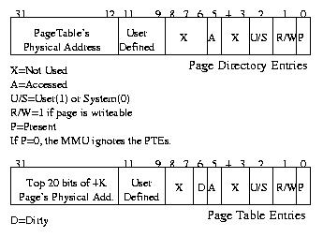
Page Table Directory and
Page Table content

Slide 17
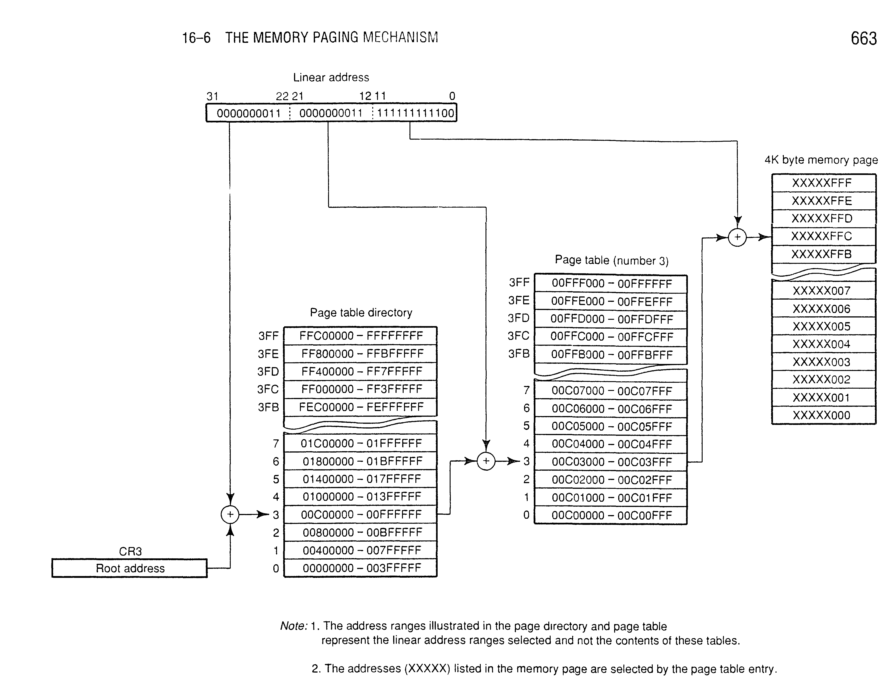
Linear Address translation example

Slide 18
Privilege Levels
Prohibited direct access
Permitted through controlled gates
User Application
Graphic Interface
Driver
Kernel
Prohibited X

Slide 19
MIXING PRIVILEGE LEVELS
Maximum protection is achieved by mixing privilege levels: the OS is given full privileges, while the tasks receive no special privileges. Luckily, the x86 has much to offer in order to mix privileges. If you want to execute higher-privileged code, such as directly calling an OS function at CPL 0 from a CPL 3 task, you can use call gates

Slide 20
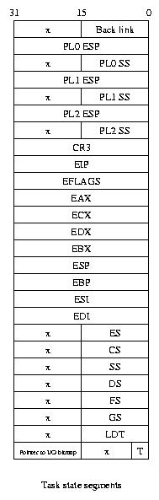
Task State Segment

Slide 21
Data Structures
Descriptors
GDT Global Descriptor Table
LDT Local Descriptor Table
IDT Interrupt Descriptor Table (similar to Interrupt Vector in Real Mode)
Task State Segment
Paging Directory two levels
  1 Page Table Directory
  1024 Page tables

