Slide 1
MPLS Layer 3 VPNs
Notes:
1

Slide 2

Agenda
Notes:
2

Slide 3
Agenda
MPLS L3VPNs
Traceroute in an MPLS VPN
PE-CE Routing Protocols
  Static
  RIPv2
  BGP
  OSPF
  EIGRP
  Deployment Scenario with BGP
  Deployment Scenario with OSPF
  Deployment Scenario with EIGRP
6vPE

Slide 4

MPLS Layer 3 VPNs
Notes:
4

Slide 5
Driving Forces for MPLS L3-VPNs
Low cost and scalable WAN to replace traditional Layer 2 Technologies (ATM/FR)
Separate networks for security, policy and economic/political reasons - Segmentation
Not a Core Business activity and expectation of cost savings
  No need to invest in high cost equipment
  Pay as you go model
  Reduce the cost of maintaining high cost and skilled IT staff

Slide 6
Driving Forces for MPLS L3-VPNs
Other factors include:
  Limited Geographic reach (cost)
  Reluctance to share the routing info
  Limited flexibility
Larger enterprises with disparate business entities
and economies of scale approaching that of a Tier 2
or Tier 3 ISP
Bandwidth, performance, or other requirements that cannot be met by public service provider networks
Business mandates on separation, segmentation and Virtualization of Traffic

Slide 7
Terminology
LSR: label switch router
LSP: label switched path
  The chain of labels that are swapped at each hop to get from one LSR to another
VRF: VPN routing and forwarding
  Mechanism in Cisco IOS® used to build per-customer RIB and FIB
MP-BGP: multiprotocol BGP
PE: provider edge router interfaces with CE routers
P: provider (core) router, without knowledge of VPN
VPNv4: address family used in BGP to carry MPLS-VPN routes
RD: route distinguisher
  Distinguish same network/mask prefix in different VRFs
RT: route target
  Extended community attribute used to control import and export policies of VPN routes
LFIB: label forwarding information base
FIB: forwarding information base

Slide 8
MPLS VPN Architecture
An MPLS VPN combines the best features of an overlay VPN and a peer-to-peer VPN:
  PE routers participate in customer routing, guaranteeing optimum routing between sites and easy provisioning.
  PE routers carry a separate set of routes for each customer (similar to the dedicated PE router approach).
  Customers can use overlapping addresses.

Slide 9
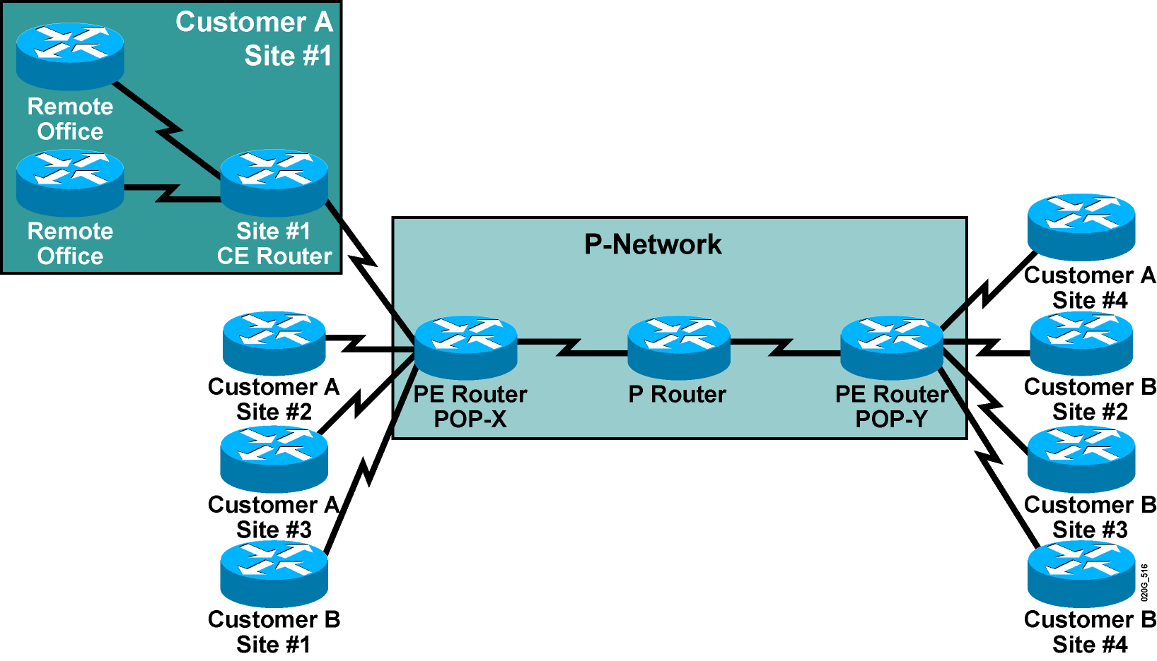
MPLS VPN Architecture (Cont.)
Terminology

Slide 10
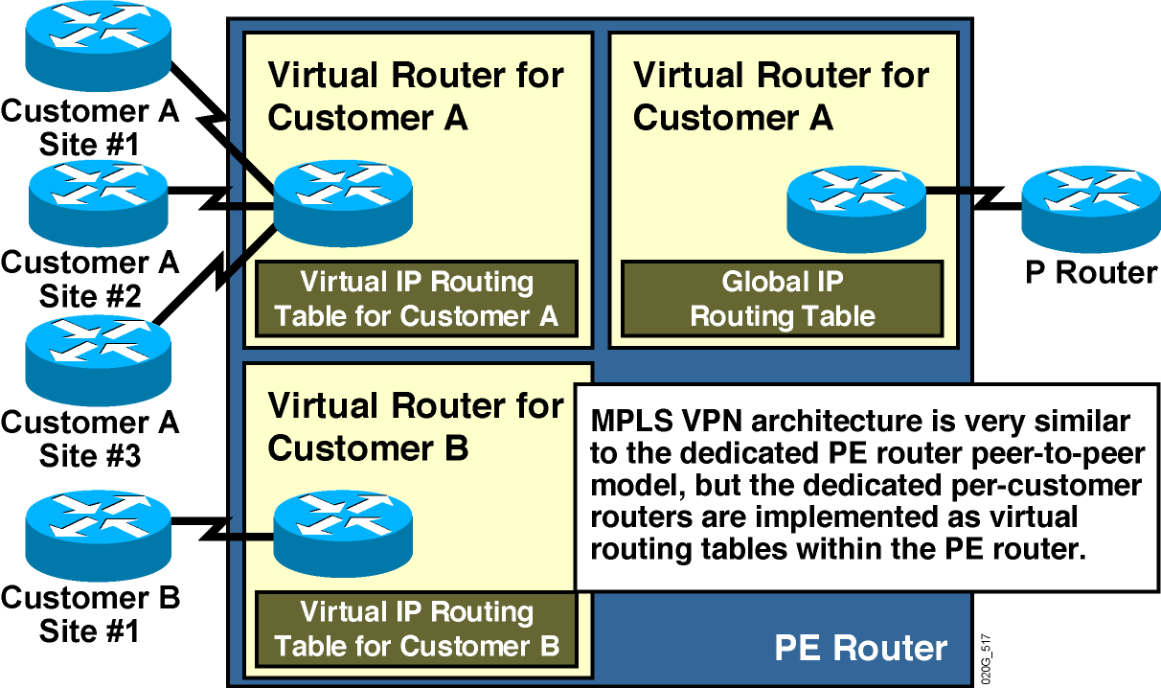
PE Router Architecture

Slide 11
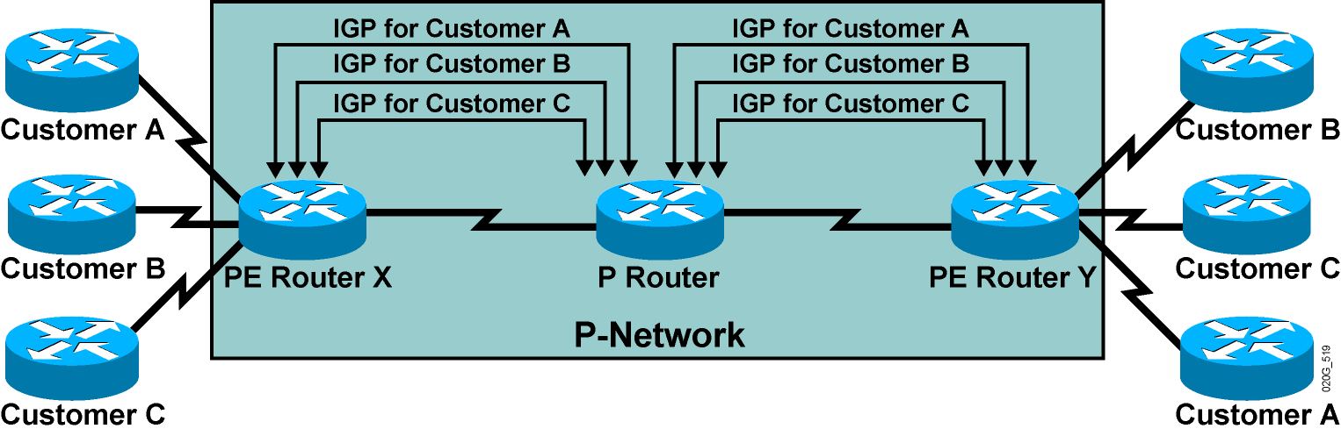
Propagation of Routing Information
Across the P-Network
Question: How will PE routers exchange customer routing information?
Answer #1: Run a dedicated Interior Gateway Protocol (IGP) for each customer
across the P-network.
This is the wrong answer for the following reasons:
    The solution does not scale.
    P routers carry all customer routes.

Slide 12
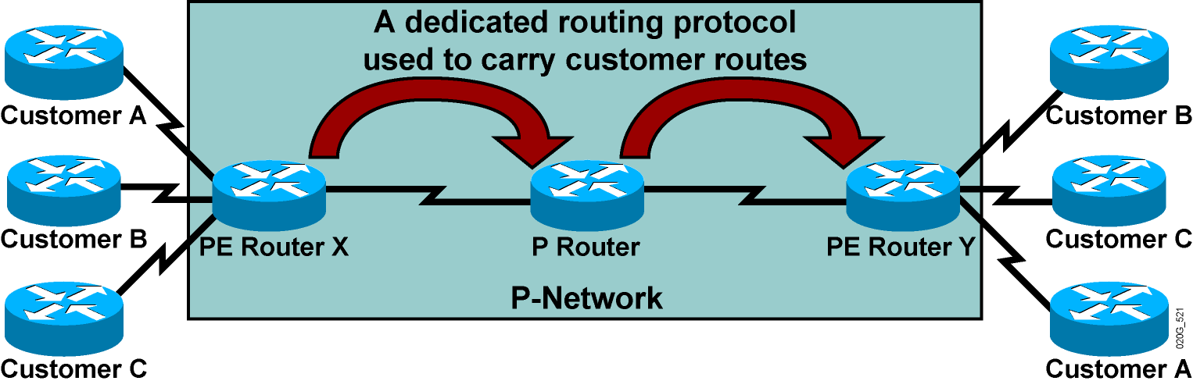
Propagation of Routing Information
Across the P-Network (Cont.)
Question: How will PE routers exchange customer routing information?
Answer #2: Run a single routing protocol that will carry all customer routes
inside the provider backbone.
Better answer, but still not good enough:
    P routers carry all customer routes.

Slide 13
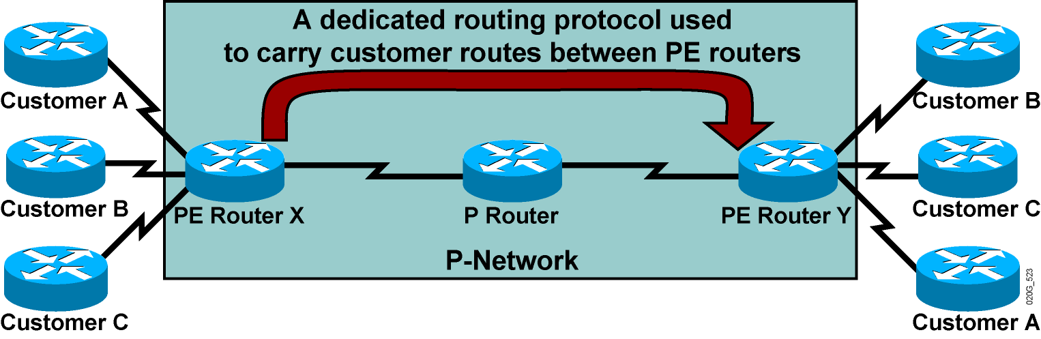
Propagation of Routing Information
Across the P-Network (Cont.)
Question: How will PE routers exchange customer routing information?
Answer #3: Run a single routing protocol that will carry all customer routes between PE routers. Use MPLS labels to exchange packets
between PE routers.
The best answer:
  P routers do not carry customer routes; the solution is scalable.

Slide 14
Propagation Routing Information
Across the P-Network (Cont.)
Question: Which protocol can be used to carry customer routes between
PE routers?
Answer: The number of customer routes can be very large. BGP is the only
routing protocol that can scale to a very large number of routes.
Conclusion:
BGP is used to exchange customer routes directly between PE routers.

Slide 15
Propagation of Routing Information
Across the P-Network (Cont.)
Question: How will information about the overlapping subnets of two customers be propagated via a single routing protocol?
Answer: Extend the customer addresses to make them unique.

Slide 16
Route Distinguishers
12 Bytes
100:1
10.10.10.0
RD
+ IPv4
VPNv4 Address
  The 64-bit route distinguisher (RD) is prepended to an IPv4 address to make it globally unique.
  The resulting address is a VPNv4 address.
  VPNv4 addresses are exchanged between PE routers via BGP.
    BGP that supports address families other than IPv4 addresses is called Multiprotocol BGP (MP-BGP).

Slide 17
Route Distinguishers (Cont.)
Route Distinguisher Format
Autonomous System
VPN Identifier
IP Address
VPN Identifier
8 Bytes
Service Providers can use their BGP AS along with VPN customer identifier
Service Provider who do not have BGP AS, can use an IP address

Slide 18
Route Distinguishers (Cont.)
100:2
10.10.10.0
100:1
10.10.10.0
VPNv4 Addresses
MP-iBGP update
Customer A has RD of 100:1
Customer B has RD of 100:2
Route Distinguisher keeps Customer A’s update unique from Customer B in the MP-iBGP update, although they use the same IP address

Slide 19
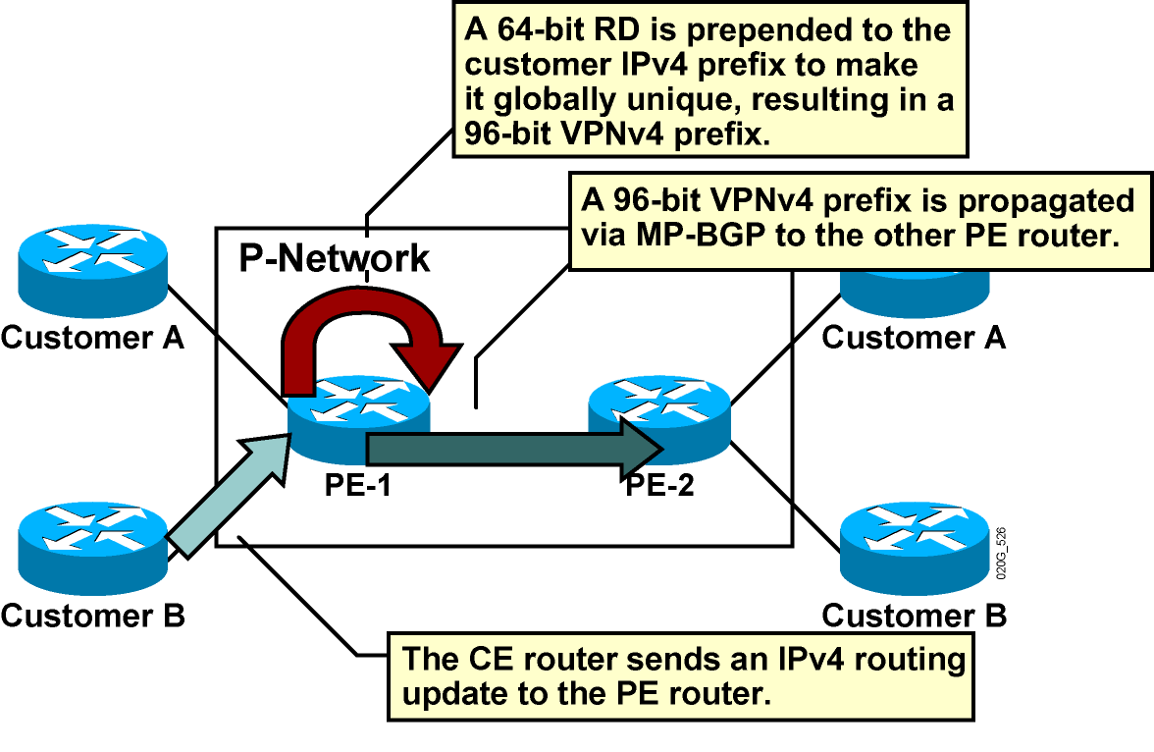
Route Distinguishers (Cont.)

Slide 20
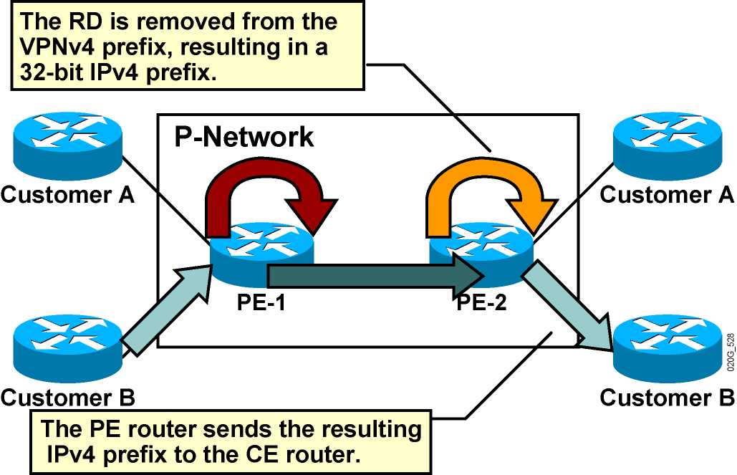
Route Distinguishers (Cont.)

Slide 21
Route Distinguishers (Cont.)
Usage in an MPLS VPN
  The RD has no special meaning.
  Used only to make potentially overlapping IPv4 addresses globally unique.
  The RD could serve as a VPN identifier, but this design could not support all topologies required by the customers.

Slide 22
Route Targets
Why Are They Needed?
  Some sites have to participate in more than
  one VPN.
  The RD cannot identify participation in more than one VPN.
  RTs were introduced in the MPLS VPN architecture to support complex VPN topologies.
    A different method is needed in which a set of identifiers can be attached to a route.

Slide 23
Route Targets (Cont.)
What Are They?
100:2
10.10.10.0
Customer B: 2
VoIP VPN: 2
VPNv4 update
Route-Targets
MP-iBGP update
  RTs are additional attributes attached to VPNv4 BGP routes to indicate VPN membership.
  Format is same as Route Distinguisher
  Extended BGP communities are used to encode these attributes.
    Extended communities carry the meaning of the attribute together with its value.
  Any number of RTs can be attached to a single route.

Slide 24
Route Targets (Cont.)
How Do They Work?
  Export RTs:
    Identifying VPN membership
    Appended to the customer route when it is converted into a VPNv4 route
  Import RTs:
    Associated with each virtual routing table
    Select routes to be inserted into the virtual routing table

Slide 25
Virtual Private Networks Redefined
With the introduction of complex VPN topologies, VPNs have had to be redefined:
  A VPN is a collection of sites sharing common routing information.
  A site can be part of different VPNs.
  A VPN can be seen as a community of interest (closed user group, or CUG).
  Complex VPN topologies are supported by multiple virtual routing tables on the PE routers.

Slide 26
Impact of Complex VPN Topologies on Virtual Routing Tables
  A virtual routing table in a PE router can be used only for sites with identical connectivity requirements.
  Complex VPN topologies require more than one virtual routing table per VPN.
  As each virtual routing table requires a distinct RD value, the number of RDs in the MPLS VPN network increases.

Slide 27
Important points to note for RT and RD
  Route Distinguishers (RD) are only used to make ipv4 VPN addresses unique when advertising them over MP-iBGP, by making them vpnv4 prefixes
  We can have one RD per vrf
  Only one vrf can be assigned to an interface
  Route Targets (RT) are used for VPN membership, so that complex scenarios can be addressed
  VPN is the set of rules for customer connectivity and can be very complex
  A VPN may have several RTs

Slide 28
MP-BGP Extensions
BGP has been extended in the form in Multi-protocol (MP)-BGP to carry routes from multiple “address families” in the form of VPNv4-AF
VPNv4-AF is a 12-byte field of the form:
  Route-Distinguisher [RD] 8-byte
  IPv4-Address 4-byte
Route-Target Attribute
Label value
8 Bytes
4 Bytes
8 Bytes
3 Bytes
1:1
10.1.1.0
2:2
50
RD
IPv4
Route-Target
Label
VPNv4
MP-IBGP update with RD, RT, and label

Slide 29
MP-BGP Extensions
PE11#show ip bgp vpnv4 vrf BGP-PE-CE 1.1.1.1
BGP routing table entry for 11:1:1.1.1.1/32, version 2
Paths: (1 available, best #1, table BGP-PE-CE)
Advertised to update-groups:
2
1
140.0.0.1 (via BGP-PE-CE) from 140.0.0.1 (1.1.1.1)
Origin IGP, metric 0, localpref 100, valid, external, best
Extended Community: RT:1:1
mpls labels in/out 35/nolabel
Route Target for Coloring of the Prefixes
VRF Table
VPNv4-Address
RD: 11:1
IP Address: 1.1.1.1/32

Slide 30
MPLS VPN Routing Requirements
  CE routers have to run standard IP routing software.
  PE routers have to support MPLS VPN services and Internet routing.
  P routers have no VPN routes.

Slide 31
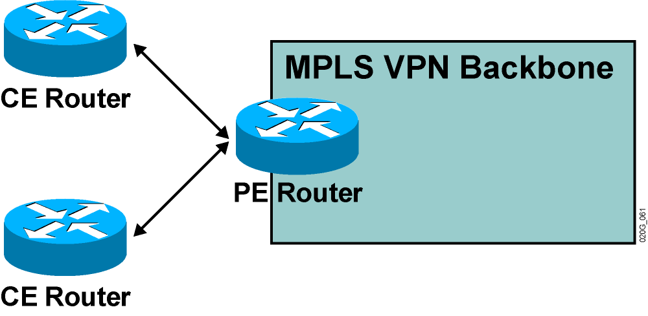
MPLS VPN Routing
CE Router Perspective
  The CE routers run standard IP routing software and exchange routing updates with the PE router.
    PE-CE protocols can be EBGP, OSPF, RIPv2, EIGRP, and static routes.
  The PE router appears as another router in the C-network.

Slide 32
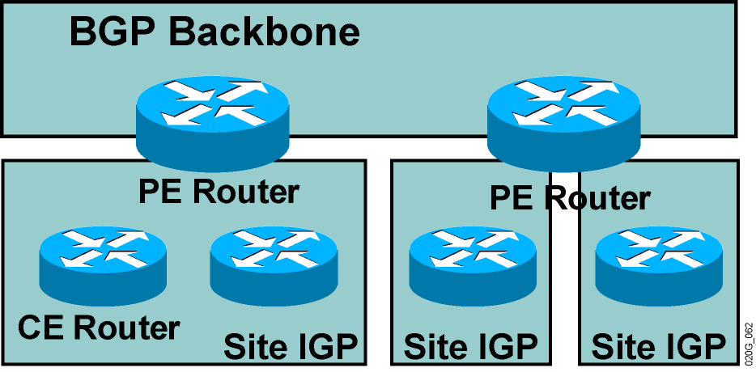
MPLS VPN Routing (cont.)
Overall Customer Perspective
  To the customer, the PE routers appear as core routers connected via a BGP backbone.
  The usual BGP and IGP design rules apply.
  The P routers are hidden from the customer.

Slide 33
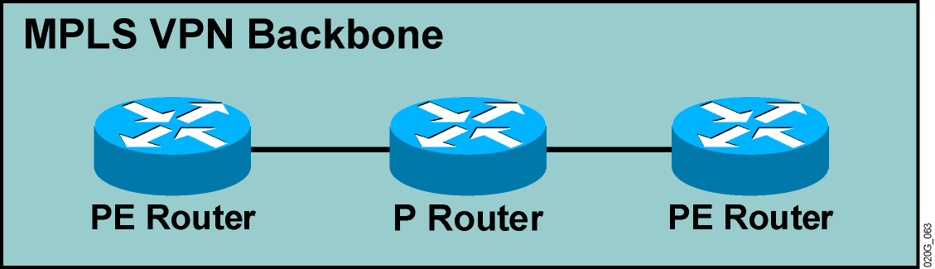
MPLS VPN Routing (Cont.)
P Router Perspective
  P routers do not participate in MPLS VPN routing and do not carry VPN routes.
  P routers run backbone IGP with the PE routers and exchange information about global subnets (core links and loopbacks).

Slide 34
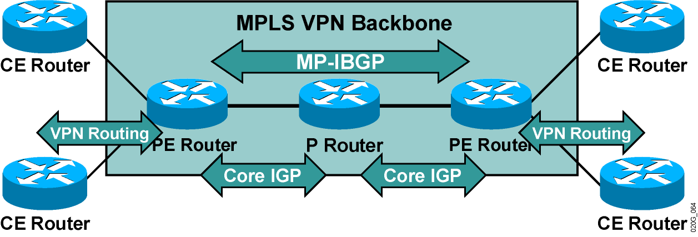
MPLS VPN Routing (Cont.)
PE Router Perspective
PE routers:
  Exchange VPN routes with CE routers via per-VPN routing protocols
  Exchange core routes with P routers and PE routers via core IGP
  Exchange VPNv4 routes with other PE routers via MP-IBGP sessions

Slide 35
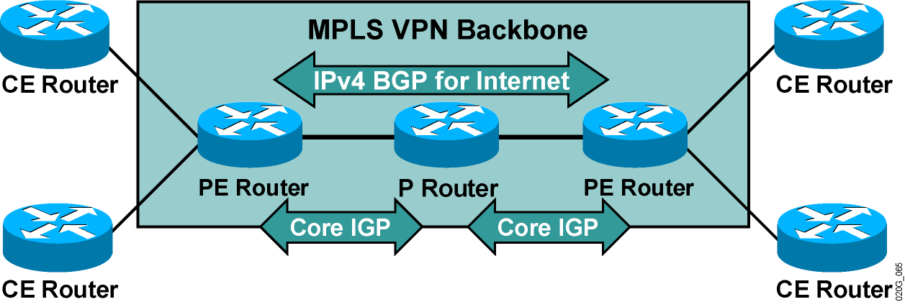
Support for Existing Internet Routing
PE routers can run standard IPv4 BGP in the global routing table:
  PE routers exchange Internet routes with other PE routers.
  CE routers do not participate in Internet routing.
  P routers do not need to participate in Internet routing.

Slide 36
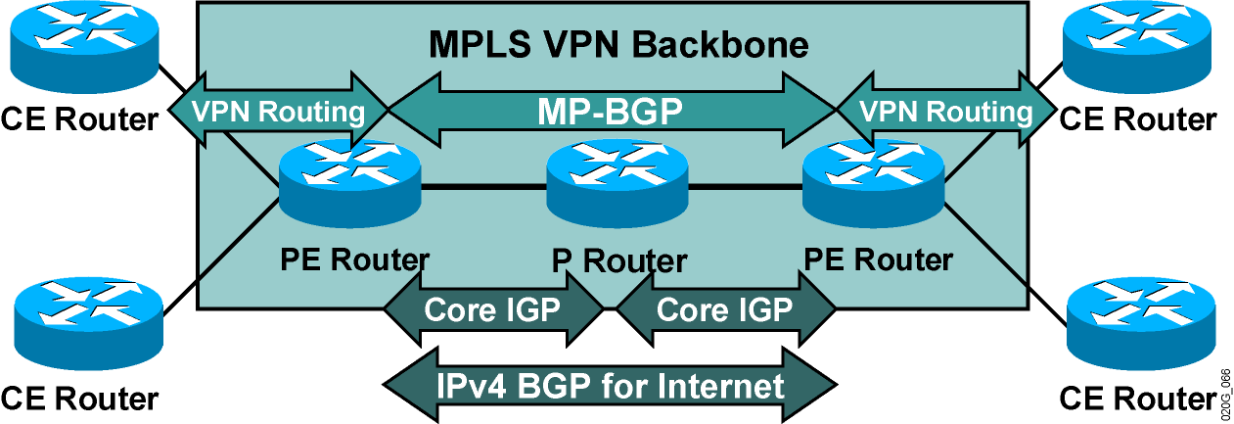
Routing Tables on PE Routers
PE routers contain a number of routing tables:
  Global routing table, which contains core routes (filled with core IGP) and Internet routes (filled with IPv4 BGP)
  VRF tables for sets of sites with identical routing requirements
  VRFs filled with information from CE routers and MP-BGP information from other PE routers

Slide 37
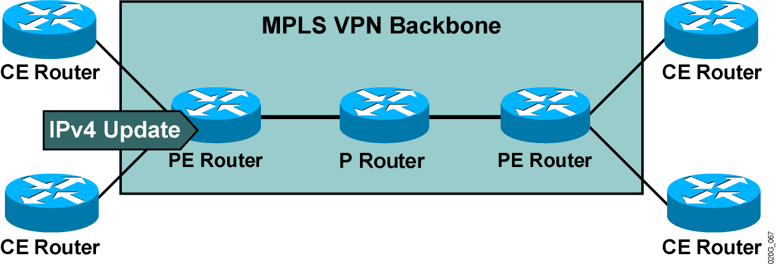
End-to-End Routing Update Flow
PE routers receive IPv4 routing updates from CE routers and install them in the appropriate VRF table.

Slide 38
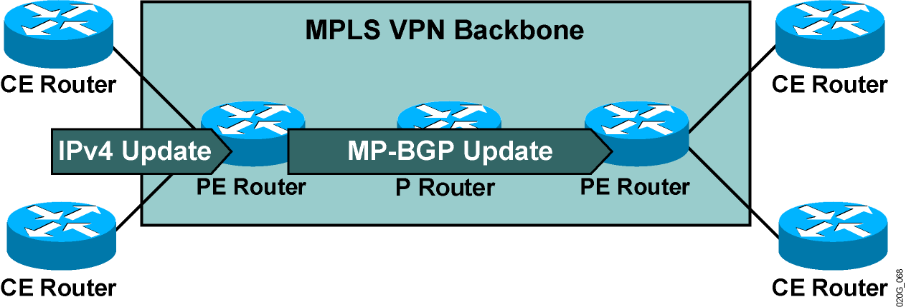
End-to-End Routing Update Flow (Cont.)
PE routers export VPN routes from VRF tables into
MP-BGP and propagate them as VPNv4 routes to other
PE routers.

Slide 39
End-to-End Routing Update Flow (Cont.)
MP-BGP Update
An MP-BGP update contains the following:
  VPNv4 address
  Extended communities
  (route targets, optionally SOO)
  Label used for VPN packet forwarding
  Any other BGP attribute (for example, AS path, local preference, MED, standard community)

Slide 40
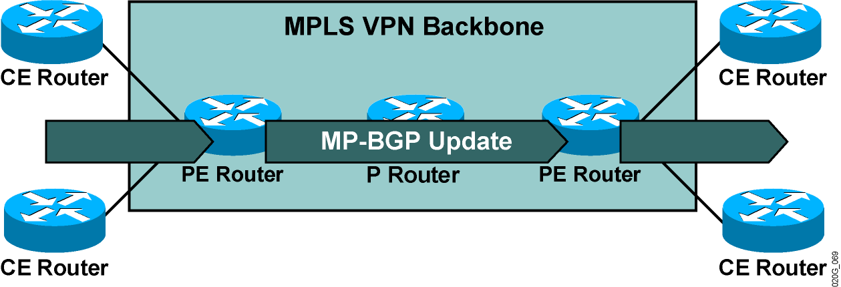
End-to-End Routing Update Flow (Cont.)
Receiving PE router imports incoming VPNv4 routes into the appropriate VRF based on route targets attached to the routes.
Routes installed in VRF are propagated to CE routers.

Slide 41
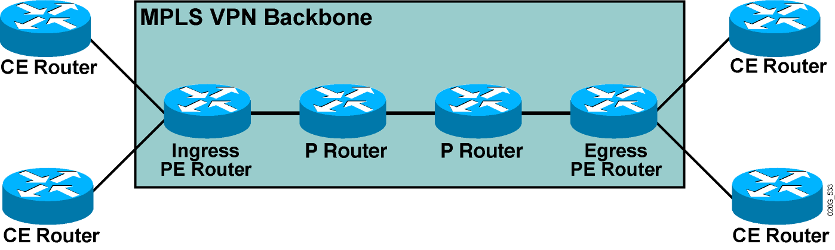
VPN Packet Forwarding Across an MPLS VPN Backbone
Question: How will the PE routers forward the VPN packets across the
MPLS VPN backbone?
Answer #1: They will label the VPN packets with an LDP label for the egress
PE router and forward the labeled packets across the MPLS backbone.

Slide 42
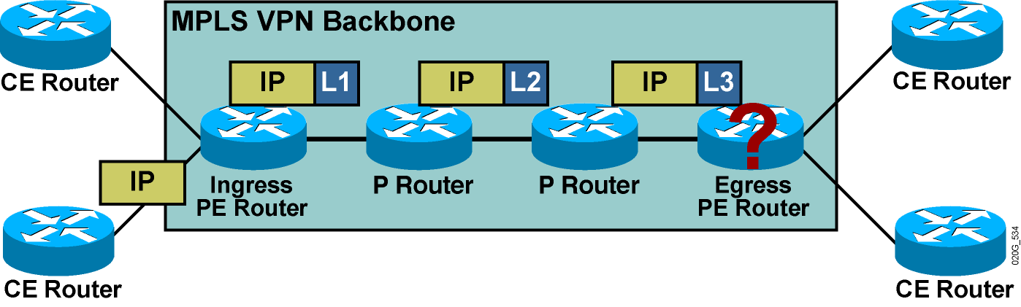
VPN Packet Forwarding Across an MPLS VPN Backbone
Question: How will the PE routers forward the VPN packets across the
MPLS VPN backbone?
Answer #1: They will label the VPN packets with an LDP label for the egress
PE router and forward the labeled packets across the MPLS backbone.
Results:
The P routers perform the label switching, and the packet reaches the
egress PE router.
However, the egress PE router does not know which VRF to use for packet
switching, so the packet is dropped.
How about using a label stack?

Slide 43
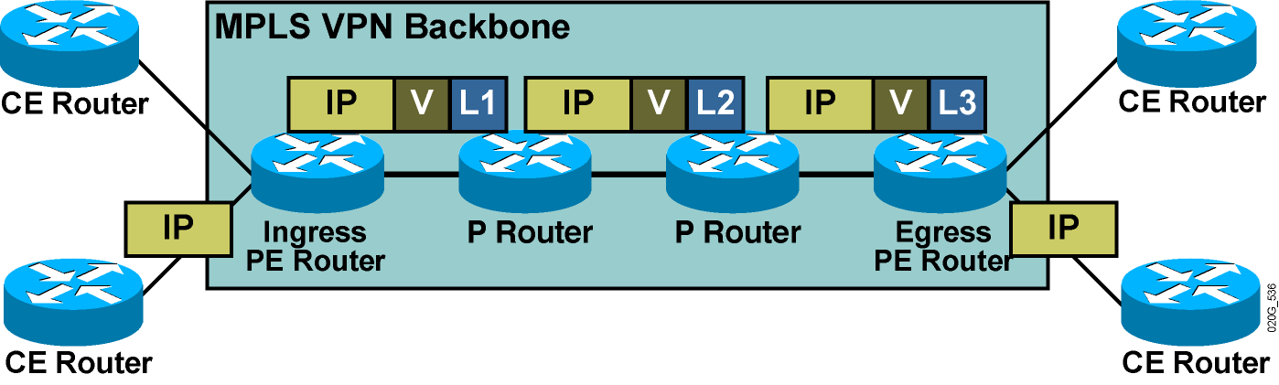
VPN Packet Forwarding Across an MPLS VPN Backbone (Cont.)
Question: How will the PE routers forward the VPN packets across the
MPLS VPN backbone?
Answer #2: They will label the VPN packets with a label stack, using the LDP label for
the egress PE router as the top label, and the VPN label assigned by the
egress PE router as the second label in the stack.
Result:
The P routers perform label switching, and the packet reaches the egress
PE router.
The egress PE router performs a lookup on the VPN label and forwards the packet
toward the CE router.

Slide 44
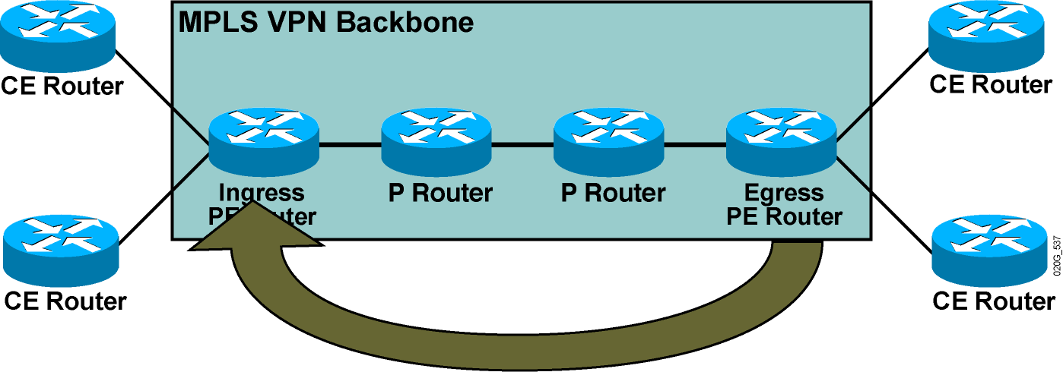
VPN Label Propagation
Question: How will the ingress PE router get the second label in the
label stack from the egress PE router?
Answer: Labels are propagated in MP-BGP VPNv4 routing updates.

Slide 45
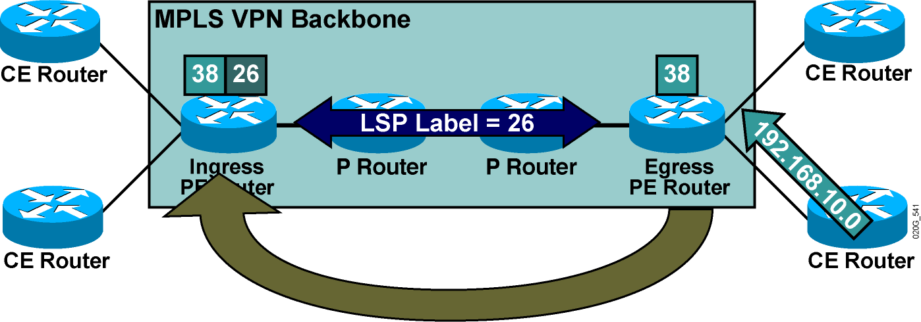
VPN Label Propagation (Cont.)
Step 1: A VPN label is assigned to every VPN route by the egress
PE router.
Step 2: The VPN label is advertised to all other PE routers in an MP-BGP
update.
Step 3: A label stack is built in the VRF table.

Slide 46
MPLS VPNs and Label Propagation
  The VPN label must be assigned by the BGP next hop.
  The BGP next hop should not be changed in the MP-IBGP update propagation.
  The PE router must be the BGP next hop.
  The label must be reoriginated if the next hop is changed.
    A new label is assigned every time that the MP-BGP update crosses the AS boundary where the next hop is changed.

Slide 47
MPLS VPN Label Stack
There are at least two labels when using MPLS-VPN
The first label is distributed by TDP/LDP
  Derived from an IGP route
  Corresponds to a PE address (VPN egress point)
  PE addresses are MP-BGP next-hops of VPN routes
The second label is distributed by MP-BGP
  Corresponds to the actual VPN route
  Identifies the PE outgoing interface or routing table
L2 Header
Label 1
Label 2
L3 Header
Data
Frame, e.g. HDLC, PPP, Ethernet

Slide 48
MPLS VPN Operation
CE
= RT?
CE
RD +
RD +
= RT?
VPN labels, RTs
PE
RR
PE
P
P
PE
RR
PE
RD +
RD +
RD +
CE
VPN labels, RTs
CE
Import routes into VRF if route-targets match (export = import)
Customer routes placed into separate VRF tables at each PE
IGP (OSPF,ISIS) used to establish reachability to destination networks.
Label Distribution Protocol establishes mappings to IGP addresses
CE-PE dynamic routing (or static) populate the VRF routing tables
MP-BGP between PE router to distribute routes between VPNs

Slide 49
MPLS VPN Forwarding Example
CE
CE
PE
PE
P
P
CE
CE
PE
PE
Swap IGP Label
(From LFIB)
POP IGP Label
(Pentultimate Hop)
Push VPN Label
(Red Route)
Push IGP Label
(Green PE Router)
Pop VPN Label
(Red Route)

Slide 50
Virtual Routing and Forwarding
A VRF is the routing and forwarding instance for a set of sites with identical connectivity requirements.
Data structures associated with a VRF:
  IP routing table
  Cisco Express Forwarding (CEF) forwarding table
  Set of rules and routing protocol parameters
  (routing protocol contexts)
  List of interfaces that use the VRF
Other information associated with a VRF:
  Route Distinguisher (RD)
  Set of import and export route targets

Slide 51
Provider Edge VRFs (PE VRFs)
Label Switching (MPLS) or Tunneling (L2TPv3)
IP Switching
MPLS/Tunnel Labels
and Route Targets
802.1q
VRF
VRF
VRF
Logical or Physical Int
(Layer 3)
VPN LSP/Tunnel
PE Router

Slide 52
VPN-Aware Routing Protocols
Routing context = routing protocol run in one VRF
  Supported by VPN-aware routing protocols:
    External BGP (EBGP), OSPF, RIP version 2 (RIPv2), EIGRP, IS-IS, Static routes
  Implemented as several instances of a single routing process (EBGP, RIPv2) or as several routing processes (OSPF)
  Independent per-instance router variables for each instance

Slide 53
VRF Routing Table
Contains routes that should be available to a particular set of sites
Analogous to standard Cisco IOS software routing table; supports same set of mechanisms
VPN interfaces (physical interface, subinterfaces, logical interfaces) assigned to VRFs
  Many interfaces per VRF
  Each interface assignable to only one VRF

Slide 54
Routing Contexts, VRF, and MP-BGP Interaction: 1/9
RIP Routing Process
VRF-A Routing Table
BGP Routing Process
Instance for VRF-A
Backbone
CE-RIP-A
Multiprotocol
BGP
Instance for VRF-B
VRF-B Routing Table
CE-RIP-B
Instance for VRF-A
CE-BGP-A
Instance for VRF-B
CE-BGP-B
Two VPNs attached to the same PE router
Each VPN represented by a VRF (VRF-A and VRF-B)
RIP and BGP running between PE and CE routers

Slide 55
Routing Contexts, VRF, and MP-BGP Interaction: 2/9
RIP Routing Process
VRF-A Routing Table
BGP Routing Process
Instance for VRF-A
Backbone
CE-RIP-A
Multiprotocol
BGP
Instance for VRF-B
VRF-B Routing Table
CE-RIP-B
Instance for VRF-A
CE-BGP-A
Instance for VRF-B
CE-BGP-B
RIP-speaking CE routers announce their prefixes to the PE router via RIP.
Instance of RIP process associated with the VRF into which the PE-CE
interface belongs collects the routes and inserts them into VRF routing
table.

Slide 56
Routing Contexts, VRF, and MP-BGP Interaction: 3/9
RIP Routing Process
VRF-A Routing Table
BGP Routing Process
Instance for VRF-A
Backbone
CE-RIP-A
Multiprotocol
BGP
Instance for VRF-B
VRF-B Routing Table
CE-RIP-B
Instance for VRF-A
CE-BGP-A
Instance for VRF-B
CE-BGP-B
BGP-speaking CE routers announce their prefixes to the PE router via BGP.
Instance of BGP process associated with the VRF into which the PE-CE
interface belongs collects the routes and inserts them into VRF routing
table.

Slide 57
Routing Contexts, VRF, and MP-BGP Interaction: 4/9
RIP Routing Process
VRF-A Routing Table
BGP Routing Process
Instance for VRF-A
Backbone
CE-RIP-A
Multiprotocol
BGP
Instance for VRF-B
VRF-B Routing Table
CE-RIP-B
Instance for VRF-A
CE-BGP-A
Instance for VRF-B
CE-BGP-B
RIP routes entered in the VRF routing table are redistributed into BGP
for further propagation into the MPLS VPN backbone.
Redistribution between RIP and BGP has to be configured for proper
MPLS VPN operation.

Slide 58
Routing Contexts, VRF, and MP-BGP Interaction: 5/9
RIP Routing Process
VRF-A Routing Table
BGP Routing Process
Instance for VRF-A
CE-RIP-A
Multiprotocol
BGP
Instance for VRF-B
VRF-B Routing Table
CE-RIP-B
Instance for VRF-A
CE-BGP-A
Instance for VRF-B
CE-BGP-B
Route distinguisher is prepended during route export to the BGP routes
from VRF instance of BGP process to convert them into VPNv4 prefixes.
Route targets are attached to these prefixes.
VPNv4 prefixes are propagated to other PE routers.

Slide 59
Routing Contexts, VRF, and MP-BGP Interaction: 6/9
RIP Routing Process
VRF-A Routing Table
BGP Routing Process
Instance for VRF-A
CE-RIP-A
Multiprotocol
BGP
Instance for VRF-B
VRF-B Routing Table
CE-RIP-B
Instance for VRF-A
CE-BGP-A
Instance for VRF-B
CE-BGP-B
VPNv4 prefixes are received from other PE routers.
The VPNv4 prefixes are inserted into proper VRF routing tables based
on their route targets and import route targets configured in VRFs.
Route distinguisher is removed during this process.

Slide 60
Routing Contexts, VRF, and MP-BGP Interaction: 7/9
RIP Routing Process
VRF-A Routing Table
BGP Routing Process
Instance for VRF-A
Backbone
CE-RIP-A
Multiprotocol
BGP
Instance for VRF-B
VRF-B Routing Table
CE-RIP-B
Instance for VRF-A
CE-BGP-A
Instance for VRF-B
CE-BGP-B
Routes received from backbone MP-BGP and imported
into a VRF are forwarded as IPv4 routes to EBGP CE neighbors attached
to that VRF.

Slide 61
Routing Contexts, VRF, and MP-BGP Interaction: 8/9
RIP Routing Process
VRF-A Routing Table
BGP Routing Process
Instance for VRF-A
CE-RIP-A
Multiprotocol
BGP
Instance for VRF-B
VRF-B Routing Table
CE-RIP-B
Instance for VRF-A
CE-BGP-A
Instance for VRF-B
CE-BGP-B
MP-IBGP routes imported into a VRF are redistributed into the instance
of RIP configured for that VRF.
Redistribution between BGP and RIP has to be configured for end-
to-end RIP routing between CE routers.

Slide 62
Routing Contexts, VRF, and MP-BGP Interaction: 9/9
RIP Routing Process
VRF-A Routing Table
BGP Routing Process
Instance for VRF-A
Backbone
CE-RIP-A
Multiprotocol
BGP
Instance for VRF-B
VRF-B Routing Table
CE-RIP-B
Instance for VRF-A
CE-BGP-A
Instance for VRF-B
CE-BGP-B
Routes redistributed from BGP into a VRF instance of RIP are sent to
RIP-speaking CE routers.

Slide 63

Traceroute in an MPLS VPN
Notes:
63

Slide 64
TTL Field in Labels
Only the TTL field in the label at the top of the stack counts
The outgoing TTL value is only a function of the incoming TTL value
Outgoing TTL is one less than incoming TTL
If outgoing TTL = 0, packet is not forwarded (not even stripped and forwarded as an ip packet)

Slide 65
Copying of TTL field
When an ip packet is first labeled, the TTL field is copied from the ip header to the MPLS header (after being decremented by 1)
When the label stack is removed, the outgoing TTL value is copied to the TTL field in the ip header
  Unless MPLS TTL > IP TTL

Slide 66
Traceroute in IP Network
all routers switch ip packets
probe 1
10.1.1.1 TTL = 1
udp port = 35678
TTL = 0
10.1.2.1
10.1.2.1 TTL = 255
10.1.1.1
icmp
TTL exceeded

Slide 67
Traceroute in IP Network
all routers switch ip packets
probe 2
10.1.1.1 TTL = 2
10.1.1.1 TTL = 1
udp port = 35678
udp port = 35678
TTL = 0
10.1.2.1
10.1.2.1 TTL = 254
10.1.2.1 TTL = 255
10.1.1.1
icmp
icmp
TTL exceeded
TTL exceeded

Slide 68
Traceroute in IP Network
all routers switch ip packets
probe 3
10.1.1.1 TTL = 3
10.1.1.1 TTL = 2
10.1.1.1 TTL = 1
udp port = 35678
udp port = 35678
udp port = 35678
TTL = 0
10.1.2.1
10.1.2.1 TTL = 253
10.1.2.1 TTL = 254
10.1.2.1 TTL = 255
10.1.1.1
icmp
icmp
icmp
TTL exceeded
TTL exceeded
TTL exceeded

Slide 69
Traceroute in IP Network
all routers switch ip packets
probe 4
10.1.1.1 TTL = 4
10.1.1.1 TTL = 3
10.1.1.1 TTL = 2
10.1.1.1 TTL = 1
udp port = 35678
udp port = 35678
udp port = 35678
udp port = 35678
udp port
35678?
10.1.2.1
10.1.2.1 TTL = 252
10.1.2.1 TTL = 253
10.1.2.1 TTL = 254
10.1.2.1 TTL = 255
10.1.1.1
icmp
icmp
icmp
icmp
port unreachable
port unreachable
port unreachable
port unreachable

Slide 70
Traceroute in MPLS VPN Network
MPLS
VPN1
VPN1
PE
P
PE
CE
CE
10.1.2.1
10.1.1.1

Slide 71
Traceroute in MPLS VPN Network
LFIB (VRF 1)
LFIB
LFIB (VRF 1)
In label | prefix | Out interface | Out label
- | 10.1.1.0/24 | pos 0 | 26 32
31 | 10.1.2.0/24 | pos 1 | -
In label | prefix | Out interface | Out label
26 | 1.1.1.1/32 | pos 0 | pop
29 | 1.1.1.2/32 | pos 1 | pop
In label | prefix | Out interface | Out label
32 | 10.1.1.0/24 | pos 0 | -
- | 10.1.2.0/24 | pos 1 | 29 31
VPN1
BGP RID = 1.1.1.1
BGP RID = 1.1.1.2
VPN1
PE
P
PE
CE
CE
1
0
1
0
1
0
10.1.2.1
10.1.1.1

Slide 72
Traceroute in MPLS VPN Network
probe 1
10.1.1.1 TTL = 1
TTL = 0
udp port = 35678
PE
P
PE
CE
CE
10.1.2.1
10.1.2.1 TTL = 255
10.1.1.1
icmp
TTL exceeded
Notes:
In the case of MPLS VPN, the P routers cannot send the ICMP messages back to the packet’s source, since the P routers do not have the route to this ip address. In MPLS networks, this could be solved by introducing a default route into the IGP of the MPLS cloud. This default route would then take the ICMP message to a router with full routing information. In MPLS VPN this would be a PE router with full routing tables of all VPNs. But, since the ip addressing of VPNs can be overlapping, this is not possible. The ICMP message that would have followed the default route and ended up at that PE router with full routing information would not know for which VPN the ICMP messages is destined. The reason for this is that the second label (the one designating the exit PE/BGP router and designating the VPN) is gone.
The solution is as follows : in order to send the ICMP message to the source of a packet, the label stack is copied from the original packet to the ICMP message. This will cause the message to proceed in the direction of the original packet’s destination, rather then it’s source. The labeled ICMP message will continue until the destination PE. At this PE, the packet is forwarded according to the label(s) to the CE as an IP packet. The CE then forwards the ICMP packet back to the original packet’s ip source address.

Slide 73
Traceroute in MPLS VPN Network
probe 2
tag-switching ip propagate-ttl on PE routers (default behaviour)
IGP label
label 26 TTL = 1
label 32 TTL = 255
vpn label
label 32
10.1.2.1 TTL = 255
10.1.2.1 TTL = 254
10.1.1.1 TTL = 2
10.1.1.1 TTL = 1
ttl = 0
icmp
icmp
udp port = 35678
udp port = 35678
TTL exceeded
TTL exceeded
PE
P
PE
CE
CE
10.1.2.1
10.1.2.1 TTL = 250
label 31 TTL = 251
label 29 TTL = 252
10.1.2.1 TTL = 253
10.1.1.1
icmp
10.1.2.1 TTL = 252
icmp
TTL exceeded
label 31
TTL exceeded
icmp
10.1.2.1 TTL = 252
TTL exceeded
icmp
TTL exceeded
Notes:
In the case of MPLS VPN, the P routers cannot send the ICMP messages back to the packet’s source, since the P routers do not have the route to this ip address. In MPLS networks, this could be solved by introducing a default route into the IGP of the MPLS cloud. This default route would then take the ICMP message to a router with full routing information. In MPLS VPN this would be a PE router with full routing tables of all VPNs. But, since the ip addressing of VPNs can be overlapping, this is not possible. The ICMP message that would have followed the default route and ended up at that PE router with full routing information would not know for which VPN the ICMP messages is destined. The reason for this is that the second label (the one designating the exit PE/BGP router and designating the VPN) is gone.
The solution is as follows : in order to send the ICMP message to the source of a packet, the label stack is copied from the original packet to the ICMP message. This will cause the message to proceed in the direction of the original packet’s destination, rather then it’s source. The labeled ICMP message will continue until the destination PE. At this PE, the packet is forwarded according to the label(s) to the CE as an IP packet. The CE then forwards the ICMP packet back to the original packet’s ip source address.

Slide 74
Traceroute : Example
singularity#traceroute 10.1.2.5
Type escape sequence to abort.
Tracing the route to 10.1.2.5
1 10.1.1.26 [MPLS: Label 12310 Exp 0] 0 msec 0 msec 4 msec
2 10.1.1.2 [MPLS: Label 12313 Exp 0] 0 msec 0 msec 0 msec
3 10.1.1.6 [MPLS: Label 12312 Exp 0] 0 msec 4 msec 0 msec
4 10.1.1.30 0 msec * 0 msec
singularity#traceroute vrf one 10.1.4.5
Type escape sequence to abort.
Tracing the route to 10.1.4.5
1 10.1.1.26 [MPLS: Labels 12310/29 Exp 0] 0 msec 0 msec 4 msec
2 10.1.1.2 [MPLS: Labels 12313/29 Exp 0] 0 msec 0 msec 0 msec
3 10.1.1.6 [MPLS: Labels 12312/29 Exp 0] 0 msec 0 msec 0 msec
4 10.1.4.6 [MPLS: Label 29 Exp 0] 0 msec 0 msec 4 msec
5 10.1.4.5 0 msec * 0 msec
MPLS
MPLS VPN

Slide 75
TTL Commands
forwarding -> tag ip propagate-ttl forwarded (default)
  ip ttl is copied to label ttl
not forwarding- > no tag ip propagate-ttl forwarded
  MPLS ttl is set to 255
  MPLS Core is “invisible” in traceroutes
forwarding locally -> tag ip propagate-ttl local
  IP packets coming from the CE are imposed with a label carrying ttl = 255
  IP packets originated on PE within the vrf get label ttl = ip ttl
  Result :
    a traceroute from vrf on PE to a vrf destination, will still show all the hops : provider sees all hops in the MPLS cloud
    a traceroute from CE to a VRF destination show the MPLS cloud as one ip hop : customer does not see the number of hops in the MPLS cloud

Slide 76
No Tag IP Propagate-ttl Forwarded
Set on LSR doing ip->mpls, so on PEs
Traceroute CE to CE
moorcock#traceroute 10.1.5.2
1 10.1.4.2 4 msec 0 msec 4 msec
2 10.1.1.26 [MPLS: Labels 12310/30 Exp 0] 4 msec 4 msec 8 msec
3 10.1.1.2 [MPLS: Labels 12313/30 Exp 0] 8 msec 4 msec 4 msec
4 10.1.1.6 [MPLS: Labels 12312/30 Exp 0] 8 msec 8 msec 4 msec
5 10.1.4.6 [MPLS: Label 30 Exp 0] 4 msec 4 msec 4 msec
6 10.1.4.5 4 msec * 4 msec
moorcock#traceroute 10.1.5.2
1 10.1.4.2 0 msec 0 msec 4 msec
2 10.1.4.5 4 msec * 4 msec
tag ip propagate-ttl forwarded
local PE
P
P
P
remote PE
remote CE
no tag ip propagate-ttl forwarded
local PE
remote CE

Slide 77
Traceroute in MPLS VPN Network
probe 2
no tag-switching ip propagate-ttl on PE routers
IGP label
label 26 TTL = 255
vpn label
label 32
label 32 TTL = 254
udp port
35678?
10.1.1.1 TTL = 2
10.1.1.1 TTL = 1
10.1.1.1 TTL = 1
10.1.1.1 TTL = 1
udp port = 35678
udp port = 35678
udp port = 35678
udp port = 35678
PE
P
PE
CE
CE
10.1.2.1
10.1.2.1 TTL = 253
label 31 TTL = 254
label 29 TTL = 255
10.1.2.1 TTL = 255
10.1.1.1
icmp
10.1.2.1 TTL = 254
icmp
port unreachable
label 31
port unreachable
icmp
10.1.2.1 TTL = 254
port unreachable
icmp
port unreachable
Notes:
In the case of MPLS VPN, the P routers cannot send the ICMP messages back to the packet’s source, since the P routers do not have the route to this ip address. In MPLS networks, this could be solved by introducing a default route into the IGP of the MPLS cloud. This default route would then take the ICMP message to a router with full routing information. In MPLS VPN this would be a PE router with full routing tables of all VPNs. But, since the ip addressing of VPNs can be overlapping, this is not possible. The ICMP message that would have followed the default route and ended up at that PE router with full routing information would not know for which VPN the ICMP messages is destined. The reason for this is that the second label (the one designating the exit PE/BGP router and designating the VPN) is gone.
The solution is as follows : in order to send the ICMP message to the source of a packet, the label stack is copied from the original packet to the ICMP message. This will cause the message to proceed in the direction of the original packet’s destination, rather then it’s source. The labeled ICMP message will continue until the destination PE. At this PE, the packet is forwarded according to the label(s) to the CE as an IP packet. The CE then forwards the ICMP packet back to the original packet’s ip source address.

Slide 78

PE-CE Routing Protocols
Notes:
78

Slide 79
Configuring PE-CE Routing Protocols
PE-CE routing protocols are configured for individual VRFs.
Per-VRF routing protocols can be configured in two ways:
  There is only one BGP or RIP process per router,
  per-VRF parameters are specified in routing contexts, which are selected with the address family command.
  A separate OSPF process has to be started for each VRF.

Slide 80
3.1
Static Routing

Slide 81
Static Routing
Highly scalable and secured
Ideal for single attached sites (one way out)
For multi-homed sites, static routing may not provide re-routing capabilities in case of certain failure scenarios – highly discouraged
For every net in a given site, static configuration is required on PE
For traffic leaving the site (single homed), a static default route could be used on CE
Can co-exist with dynamic routing protocols

Slide 82
Static PE-CE:
Advertise this prefix
across MPLS Cloud
to all PEs using MP-BGP
VPNv4-Address
MP-iBGP Update:
RD:11:1 Next-Hop=PE-1
RT=All-Sites, Label=100
11:1:1.1.1.1/32
MPLS VPN
Cloud
Static route to 1.0.0.0 pointing to CE & Redistribute Static route into MP-BGP
PE1
PE2
PE3
Static route (default)
2.0.0.0 3.0.0.0
CE1
CE2
CE3
Site 1
Site 2
Site 3

Slide 83
3.2
RIPv2 Routing

Slide 84
RIPv2
Provides a simple distance vector protocol to exchange routing information
Hop count limit of 15
Could be used at smaller sites where hop-count is much less than 15
Supports multi-homed sites with re-routing capabilities

Slide 85
RIPv2 PE-CE:
Advertise this prefix
across MPLS Cloud
to all PEs using MP-BGP
VPNv4-Address
MP-iBGP Update:
RD:11:1 Next-Hop=PE-1
Metric : RIP metric copied
RT=All-Sites, Label=100
11:1:1.1.1.1/32
MPLS VPN
Cloud
MP-BGP
Redistribute
learned route
into MP-BGP
PE1
PE2
PE3
Redistribute BGP route into RIP
Advertise
RIP Prefix
1.1.1.1
RIPv2
RIPv2
RIPv2
CE1
CE2
CE3
Site 1
Site 2
Site 3

Slide 86
3.3
BGP Routing

Slide 87
BGP PE-CE Requirements
Enterprise Customers choosing BGP as PE-CE protocol to peer with the Service Provider in MPLS-VPNs network should look into the following:
  Same AS number at all the customer locations
  Different AS number at the Customer Locations
  With Back Doors
  Private AS number vs. Public AS #
  Multi-homing and Loadbalancing options
  Customer sites connected to two or more Providers
BGP is one of the widely used PE-CE protocol in the MPLS-VPN environment

Slide 88
BGP PE-CE: Same AS at Customer Sites
Advertise this prefix
across MPLS Cloud
to all PEs using MP-BGP
VPNv4-Address
MP-iBGP Update:
RD:11:1 Next-Hop=PE-1
RT=All-Sites, Label=100
11:1:1.1.1.1/32
MPLS VPN
Cloud
MP-BGP
PE1
BGP
AS # 1234
Redistribute
learned route
into MP-BGP
PE2
PE3
MP-BGP
AS-Path: 1234 1
AS-Path: 1234 1
Site 3 sees its own AS #
Site 2 Sees its own AS #
Need AS-Override
option the PE2 & PE3
so that Site2 & Site 3
see the routes
Advertise
BGP Prefix
1.1.1.1
BGP
AS # 1
BGP
AS # 1
BGP
AS # 1
CE1
CE2
CE3
Site 1
Site 2
Site 3
Customer Site 1 sends the BGP routes to PE1
PE1 advertises to all the iBGP-VPNv4 peers
Remote PEs (PE2 & PE3) redistributes those routes into the local BGP peer at their sites
Site 2 & 3 CE routers will not accept the routes as they see their own AS in the AS-Path
MPLS-VPN routers need to be configured with the “AS-OVERRIDE” option so that remote CE Routers will not see their own AS in AS PATH

Slide 89
BGP PE-CE:
Same AS at Customer Sites
PE is sending the update to remote CEs for 1.1.1.1/32
BGP(4): 140.0.0.201 send UPDATE (chgflags: 0x820) 1.1.1.1/32, next 140.0.0.202, metric 0, path 1, extended community RT:1:1
CE receives the update and ignores the Update due to its own AS in the AS-Path
BGP(0): 140.0.0.202 rcv UPDATE about 1.1.1.1/32 -- DENIED due to: AS-PATH contains our own AS;
With “AS-Override” option configured on the PE Router(s)
PE is now sending the update to remote CEs for 1.1.1.1/32 with “prepend” option
BGP(4): 140.0.0.201 send UPDATE (prepend, chgflags: 0x820) 1.1.1.1/32, next 140.0.0.202, metric 0, path 1, extended community RT:1:1
CE now receives and accepts the route
BGP(0): 140.0.0.202 rcvd 1.1.1.1/32
BGP(0): Revise route installing 1 of 1 routes for 1.1.1.1/32 -> 140.0.0.202(main) to main IP table

Slide 90
BGP PE-CE: Same AS at Customer Sites
CE2#show ip bgp
Network Next Hop Metric LocPrf Weight Path
*> 1.1.1.1/32 140.0.0.202 0 65000 65000 i
*> 2.2.2.2/32 0.0.0.0 0 32768 i
*> 3.3.3.3/32 140.0.0.202 0 65000 65000 i
AS 1 is replaced by AS 65000
PE Router Configuration
!
router bgp 65000
no bgp default ipv4-unicast
bgp log-neighbor-changes
neighbor 11.11.11.11 remote-as 65000
neighbor 11.11.11.11 update-source Loopback0
neighbor 13.13.13.13 remote-as 65000
neighbor 13.13.13.13 update-source Loopback0
!
address-family vpnv4
neighbor 11.11.11.11 activate
neighbor 11.11.11.11 send-community extended
neighbor 13.13.13.13 activate
neighbor 13.13.13.13 send-community extended
exit-address-family
!
address-family ipv4 vrf BGP-PE-CE
redistribute connected
neighbor 140.0.0.201 remote-as 1
neighbor 140.0.0.201 activate
neighbor 140.0.0.201 as-override
no synchronization
exit-address-family
!

Slide 91
BGP PE-CE: Same AS at Customer Sites
Advertise this prefix
across MPLS Cloud
to all PEs using MP-BGP
VPNv4-Address
MP-iBGP Update:
RD:11:1 Next-Hop=PE-1
RT=All-Sites, Label=100
11:1:1.1.1.1/32
MPLS VPN
Cloud
MP-BGP
PE1
BGP
AS # 1234
Redistribute
learned route
into MP-BGP
PE2
PE3
MP-BGP
AS-Path: 1234 1
AS-Path: 1234 1
Site 3 sees its own AS #
Site 2 Sees its own AS #
Use “Allow-AS in” on CE2 and CE3
Advertise
BGP Prefix
1.1.1.1
BGP
AS # 1
BGP
AS # 1
BGP
AS # 1
CE1
CE2
CE3
Site 1
Site 2
Site 3
Alternate approach is to use “Allow-AS in” on Ces facing the PEs
CEs bypass the AS based loop detection mechanism
Acceptable number of AS occurrences within the AS-Path could be defined,
to detect loops

Slide 92
BGP PE-CE: Different AS at Customer Sites
Advertise this prefix
across MPLS Cloud
to all PEs using MP-BGP
MP-iBGP Update:
RD:11:1 Next-Hop=PE-1
RT=All-Sites, Label=100
11:1:1.1.1.1/32
MPLS VPN
Cloud
MP-BGP
Redistribute
learned route
into MP-BGP
PE1
PE2
BGP
AS # 1234
PE3
MP-BGP
BGP
BGP
Advertise
BGP Prefix
1.1.1.1
BGP
AS # 3
BGP
AS # 1
BGP
AS # 2
CE1
CE2
CE3
Site 1
Site 2
Site 3
Customer Site 1 sends the BGP routes to PE1
PE1 advertises to all the iBGP-VPNv4 peers
Remote PEs (PE2 & PE3) redistributes those routes into the local BGP peer at their sites
Site 2 & 3 CE routers will receive and install the routes from the PEs in the MPLS Core

Slide 93
BGP PE-CE: Different AS at Customer Sites
CE2#show ip bgp
Network Next Hop Metric LocPrf Weight Path
*> 1.1.1.1/32 140.0.0.202 0 65000 1 i
CE2#show ip route
B 1.1.1.1 [20/0] via 140.0.0.202, 00:03:14
The complete AS Path traversed by the IPv4 Prefix
CE3#show ip bgp
Network Next Hop Metric LocPrf Weight Path
*> 1.1.1.1/32 140.0.0.130 0 65000 1 i
CE3#show ip route
B 1.1.1.1 [20/0] via 140.0.0.130, 00:00:44

Slide 94
BGP PE-CE: With Back Door Connections
Advertise this prefix
across MPLS Cloud
to all PEs using MP-BGP
MPLS VPN
Cloud
MP-iBGP Update:
RD:11:1 Next-Hop=PE-1
RT=All-Sites, Label=100
11:1:1.1.1.1/32
MP-BGP
Redistribute
learned route
into MP-BGP
PE1
PE2
BGP
AS # 1234
PE3
MP-BGP
BGP
BGP
Advertise
BGP Prefix
1.1.1.1
BGP
AS # 3
BGP
AS # 1
BGP
AS # 2
IGP
IS-IS, OSPF, EIGRP
IGP
IS-IS, OSPF, EIGRP
CE1
CE2
CE3
Site 1
Site 2
Site 3
Mechanisms explained earlier are still valid
When the MP-BGP route on either PE2 or PE3 sent to CE2 or CE3 for CE1—the route will be learned as an external eBGP route with Admin. distance of 20
If via the back door the same route comes via either OSPF, IS-IS or EIGRP, Admin distance will come into the consideration
Since eBGP has Admin. Distance of 20—MPLS-Core will be used to reach the destination

Slide 95
BGP PE-CE: With Back Door Connections
CE2#show ip route 1.1.1.1
Routing entry for 1.1.1.1/32
Known via "ospf 1", distance 110, metric 11, type intra area
Last update from 140.0.0.194 on Ethernet0/0, 00:00:09 ago
We see 1.1.1.1/32 being learned via the backdoor path [OSPF]
With the BGP session being UP, we see 1.1.1.1/32 being
learned via BGP and installed into the RIB as a eBGP route
%BGP-5-ADJCHANGE: neighbor 140.0.0.202 Up
RT: closer admin distance for 1.1.1.1, flushing 1 route
RT: add 1.1.1.1/32 via 140.0.0.202, bgp metric [20/0]

Slide 96
BGP PE-CE:
With Back Door Connections
CE2#show ip route 1.1.1.1
Routing entry for 1.1.1.1/32
Known via "bgp 2", distance 20, metric 0
Tag 65000, type external
Last update from 140.0.0.202 00:02:05 ago
Route Learned via MPLS-Core as expected

Slide 97
BGP PE-CE: Private AS vs. Public AS
Enterprises that get connected to the Service Provider MPLS-VPN Network can use a BGP Private-AS number
The Private BGP-AS number will be hidden from the Global Internet
The Customer BGP AS will only be used to connect
the different customer entities

Slide 98
BGP PE-CE: MCS
Certain customers have a mission critical site example a hub that needs to be connected to the MPLS VPN Service Provider to get maximum uptime
Such sites need added mechanisms to provide redundancy and at the same time avoid looping.

Slide 99
BGP PE-CE: Loop in a MCS
Advertise this prefix
across MPLS Cloud
to all PEs using MP-BGP
MP-iBGP Update:
RD:11:1 Next-Hop=PE-1
RT=All-Sites, Label=100
11:1:1.1.1.1/32
MPLS VPN
Cloud
MP-BGP
Redistribute
learned route
into MP-BGP
PE1
PE2
BGP
AS # 1234
PE3
MP-BGP
PE2 configured
With as-override
BGP
BGP
Advertise
BGP Prefix
1.1.1.1
BGP
AS # 1
BGP
AS # 1
CE1
CE2
CE3
Site 1
Site 3
Customer Site 1 sends the BGP routes to PE1
PE1 advertises to all the iBGP-VPNv4 peers
Remote PE (PE2) redistributes those routes into the local BGP peer at their sites because it has as-override configured so it will change the AS Path.
CE2 will accept this route because it doesn’t see its AS in the AS-Path and hence we have created a loop in the routing. Why? Because CE2 would have the same route via an IGP and basis AD which route will win ????

Slide 100
BGP PE-CE: Site-of-Origin
In order to solve this loop problem, SOO was created.
Site-of-Origin is an extended community attribute that is attached to a route received from a CE router before being advertised into VPNv4 address family.
The receiving PE router matches the received SOO value with the one configured locally.
If the values match, receiving PE doesn’t send that route update to the connected CE.
SOO is configured per neighbor.

Slide 101
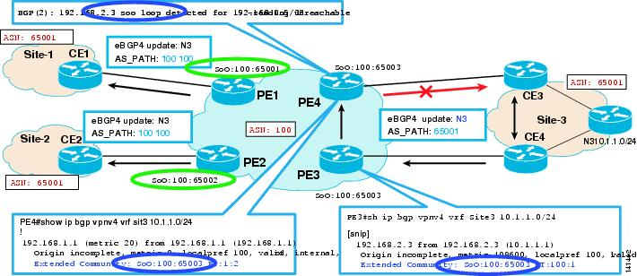
BGP PE-CE: Site-of-Origin

Slide 102
3.4
OSPF Routing

Slide 103
OSPF PE-CE Requirements
In MPLS-VPN environment, PE Routers are part of the OSPF AREA 0 (SuperBackbone)
If OSPF Domain has Area 0 routers, then at least one of those MUST be a CE router and MUST have an Area 0 link to at least one PE Router
PE MUST support one OSPF instance for each OSPF domain to which it attaches
If PE is running OSPF as its IGP, the instance of OSPF running must be separate and independent from OSPF as PE-CE

Slide 104
OSPF PE-CE—MP-BGP Extensions
Extensions to MP-BGP to Carry OSPF Routes:
OSPF Router-ID
  Each OSPF Instance has a Unique Rtr-ID
Domain-Identifier
  8-Byte value that is a valid BGP EXT Community attribute
  Identifies the how the prefix originated
Route-Type
  8-Byte value includes Area number, OSPF Route-Type
  (Intra-Inter-External-NSSA)
DN Bit
  Used for Loop prevention for Type 3 LSAs
  MUST be set when it is sent by PE to CE
Route-Tags
  MUST be included in the Type 5 LSAs that PE originates as a result of receiving external routes

Slide 105
OSPF PE-CE—MP-BGP Extensions
PE12# show ip bgp vpnv4 all 22.22.22.22
BGP routing table entry for 12:1:22.22.22.22/32, version 88
140.0.0.201 (via OSPF-Sham) from 0.0.0.0 (12.12.12.12)
Origin incomplete, metric 10, localpref 100, weight 32768, valid, sourced, best
Extended Community: RT:1:1 OSPF DOMAINID:0x0005:0x000000010200
OSPF RT:0.0.0.0:5:1 OSPF ROUTER ID:12.12.12.12:512
OSPF Route Type
Extended Community
5: External Route
1: Extern Type 2
2: Inter-Area
OSPF Router ID
OSPF Domain ID
PE11# show ip bgp vpnv4 all 2.2.2.2
OSPF RT:0.0.0.0:2:0 OSPF ROUTER ID:12.12.12.12:512

Slide 106
OSPF PE-CE Operation
Advertise this prefix
across MPLS Cloud
to all PEs using MP-BGP
MPLS VPN
Cloud
BGP
Redistribute OSPF
learned route
into MP-BGP
PE1
PE2
PE3
BGP
OSPF
OSPF
Advertise
OSPF Prefix
CE2
CE3
CE1
Site 3
Site 1
Site 2

Slide 107
OSPF PE-CE Operation : Down BIT and Tag
The MPLS VPN model has 3 levels of hierarchy and this poses some challenges during redistribution and flooding which did not exit in the 2 level model of OSPF.
In the normal OSPF the area prefixes are advertised in the backbone and vice-versa using summary type 3 LSAs
The fact that only backbone summary LSA are considered or that LSA generation is suppressed in some cases we never have flooding loops.
These techniques are not sufficient in this model.

Slide 108
OSPF - Routing Loop
MPLS-VPN Backbone
VPN-IPv4 Update
RD:110.1.1.1, Next-hop=PE-3
RT=xxx:xxx
VPN-IPv4 Update
RD:110.1.1.1, Next-hop=PE-1
RT=xxx:xxx
PE-3
Type-3 (Summary-LSA)
Link-State-ID: 110.1.1.1
Adv. Router: PE-2
PE-1
PE-2
Area 0
CE-1
Type-3 (Summary-LSA) Link-State-ID: 110.1.1.1
Adv. Router: PE-2
CE-2
Network = 110.1.1.1
Area 0
Notes:
4

Slide 109
OSPF Down Bit and Tag
Down bit and Tag are used to prevent looping and on by default.
The Down bit is bit 7 in the option field of an LSA
The Down bit is set by the PE on the LSAs describing routes coming from the BGP redistribution and need to get propagated.
When a PE receives a route from the CE, it will generate a summary LSA into the MPLS-VPN BB if and only if the Down-bit is not set on that LSA
Down bit processing is only done on PE
Down-bit check can be disabled by configuration
Notes:
4

Slide 110
OSPF - Routing Loop avoidance
VPN-IPv4 Update
RD:110.1.1.1, Next-hop=PE-3
RT=xxx:xxx
OSPF-Route-Type= 1:2:0
OSPF-Domain: xxx
VPN-IPv4 Update
RD:110.1.1.1, Next-hop=PE-1
RT=xxx:xxx
OSPF-Route-Type= 1:2:0
OSPF-Domain: xxx
MPLS-VPN Backbone
Type-3 (Summary-LSA) Down bit is set
Link-State-ID: 110.1.1.1
Adv. Router: PE-2
PE-3
PE-1
PE-2
Area 1
CE-1
Type-3 (Summary-LSA) Down bit is set
Link-State-ID: 110.1.1.1 Adv. Router: PE-2
CE-2
Network = Net-1
Area 2
Notes:
4

Slide 111
OSPF - Down bit example
2. VPN-IPv4 Update
RD:140.1.1.1, Next-hop=PE-1
RT=xxx:xxx
OSPF-Route-Type= 0.0.0.1:3:0
OSPF-Domain: xxx
3. VPN-IPv4 Update
RD:140.1.1.1, Next-hop=PE-1
RT=xxx:xxx
OSPF-Route-Type= 0.0.0.1:3:0
OSPF-Domain: xxx
MPLS-VPN Backbone
PE-1
PE-2
6. PE-1 will ignore any LSA with the
Down-bit set since they refers to a
route which has already be injected
from the MPLS-VPN backbone into
customer site
4. Type-3 (Summary-LSA) Down bit is set
LSID:140.1.1.1
Adv. Router: PE-2
Area 1
1. Type-1 Router-LSAs
LSID: 140.1.1.1
Adv. Router: x.x.x.x
5. Type-3 (Summary-LSA) Down bit is set
LSID:140.1.1.1
Adv. Router: PE-2
CE-1
CE-2
1. Type-2 Network-LSAs LSID: 140.1.1.1
Adv. Router: x.x.x.x
or
C-1
C-2
Notes:
4

Slide 112
OSPF - VPN Route Tag
The TAG is the equivalent of the down bit for type 5 and used to prevent looping
The Tag value may be configured or computed automatically for a VPN and is the same across the same OSPF domain.
Each OSPF domain should have a unique TAG value
The Tag is a 32 bit field in the type 5 LSA.
The Tag is set on the Type 5 LSA by the PE to indicate the flooding from a higher to a lower level
If a tag match is found on a Type 5 LSA, this LSA will not be considered for route computation on a PE.
Notes:
4

Slide 113
OSPF - Routing loop avoidance
VPN-IPv4 Update
RD:175.1.1.1, Next-hop=PE-3
RT=xxx:xxx
MED=20
OSPF-Route-Type= 0:5:1
OSPF-Router-ID= PE-3
OSPF-Domain: xxx
VPN-IPv4 Update
RD:175.1.1.1, Next-hop=PE-1
RT=xxx:xxx
MED=20
OSPF-Route-Type= 0:5:1
OSPF-Router-ID= PE-1
OSPF-Domain: xxx
AS 1
Type-5 (External-LSA) Link-State-ID: 175.1.1.1
Adv. Router: PE-2
Metric : 20
External Route Tag: 3489660929
TAG Complete, Path Length == 1, AS 1
MPLS-VPN Backbone
PE-3
PE-1
Type-5 external LSA Link-ID: 175.1.1.1
Adv. Router: CE-1
Metric : 20
PE-2
Area 1
Type-5 (External-LSA) Link-State-ID: 175.1.1.1
Adv. Router: PE-2
Metric : 20
External Route Tag: 3489660929
TAG Complete, Path Length == 1, AS 1
CE-1
CE-2
Network = Net-1
Area 2
Notes:
4

Slide 114
OSPF - Tag example
2. VPN-IPv4 Update
RD:150.1.1.1, Next-hop=PE-1
RT=xxx:xxx
OSPF-Domain: 100
OSPF-Route-Type= 0.0.0.1:5:1
3. VPN-IPv4 Update
RD:150.1.1.1, Next-hop=PE-1
RT=xxx:xxx
OSPF-Domain: 100
OSPF-Route-Type= 0.0.0.1:5:1
MPLS-VPN Backbone
PE-1
PE-2
5. Type-5 (External-LSA) OSPF TAG: 100
LSID:150.1.1.1
Adv. Router: PE-2
4. Type-5 (External-LSA) OSPF TAG: 100
LSID: 150.1.1.1
Adv. Router: PE-2
6. PE-1 will ignore any External LSA
(Type-5) with OSPF TAG having
provider ASN (i.e.: OSPF domain TAG).
Type-4 LSAs are never propagated into
MP-BGP anyway
5. Type-4 (ASBR-LSA)
Link-State-ID: PE-2
Adv. Router: PE-2
4. Type-4 (ASBR-LSA)
Link-State-ID: PE-2
Adv. Router: PE-2
1. Type-5 External-LSAs LSID:150.1.1.1
Adv. Router: C-1
CE-1
CE-2
Area 1
Area 2
C-1
Network = 150.1.1.1
Notes:
4

Slide 115
Customer Sites Are All in Area 0
MPLS VPN
Cloud
PE1
PE2
PE3
Area 0
Area 0
Area 0
CE1
CE2
CE3
Site 1
Site 2
Site 3
MPLS VPN Cloud is OSPF area 0
(Super Backbone)
PE Routers act as a ABR (Area Border Routers)
PE Routers redistribute OSPF routes into MPLS-VPN cloud as a Summary 3 LSA

Slide 116
Customer Sites Are All in Area 0
interface Loopback0
ip address 12.12.12.12 255.255.255.255
!
ip vrf OSPF-PECE
rd 12:1
route-target export 1:1
route-target import 1:1
!
mpls label protocol ldp
!
router ospf 1 vrf OSPF-PECE
router-id 12.12.12.12
redistribute bgp 65000 subnets
network 140.0.0.200 0.0.0.3 area 0
router bgp 65000
no bgp default ipv4-unicast
neighbor 11.11.11.11 remote-as 65000
neighbor 11.11.11.11 update-source Loopback0
!
address-family vpnv4
neighbor 11.11.11.11 activate
neighbor 11.11.11.11 send-community extended
exit-address-family
!
address-family ipv4 vrf OSPF-PECE
redistribute connected
redistribute ospf 1 vrf OSPF-PECE
no synchronization
exit-address-family

Slide 117
Customer Sites Are All in Area 0
CE1#show ip route ospf
O IA 2.2.2.2 [110/97] via 140.0.0.2, 00:18:26, Serial2/0
O IA 3.3.3.3 [110/97] via 140.0.0.2, 00:18:11, Serial2/0
CE1#show ip route 2.2.2.2
Known via "ospf 1", distance 110, metric 97, type inter area
Last update from 140.0.0.2 on Serial2/0, 00:20:50 ago
CE1#show ip route 3.3.3.3
Known via "ospf 1", distance 110, metric 97, type inter area
Last update from 140.0.0.2 on Serial2/0, 00:22:55 ago
Summary LSA from the MPLS VPN Backbone

Slide 118
Customer Sites Are in Different Areas
MPLS VPN
Cloud
PE1
PE2
PE3
Area 1
Area 2
Area 3
CE1
CE2
CE3
Site 1
Site 2
Site 3
Customer Sites are in different areas
MPLS-VPN backbone is a Super Backbone

Slide 119
Customer Sites Are in Different Areas
CE1#show ip route ospf
O IA 2.2.2.2 [110/97] via 140.0.0.2, 00:01:02, Serial2/0
O IA 3.3.3.3 [110/97] via 140.0.0.2, 00:01:02, Serial2/0
CE1#show ip route 2.2.2.2
Known via "ospf 1", distance 110, metric 97, type inter area
Last update from 140.0.0.2 on Serial2/0, 00:04:02 ago
CE1#show ip route 3.3.3.3
Known via "ospf 1", distance 110, metric 97, type inter area
Last update from 140.0.0.2 on Serial2/0, 00:04:08 ago
Summary LSA from the MPLS VPN Backbone

Slide 120
Customer Sites With Back Door Links
MPLS VPN
Cloud
PE1
PE2
PE3
Area 0
Area 2
Area 3
CE1
Area 0
CE2
Area 0
CE3
Site 1
Site 2
Site 3
Customer Sites have the Back Door links
If the backdoor links are in the same area as the PE-CE link(s), then the backdoor links will be preferred over the MPLS-Core
This is due to PE routers will advertise the Summary-route to CEs causing the Intra-Area routes preferred over the Inter-Area routes

Slide 121
Customer Sites With Back Door Links
CE1#show ip route ospf
O 2.2.2.2 [110/101] via 140.0.0.193, 00:00:52, Ethernet0/0
O 3.3.3.3 [110/201] via 140.0.0.193, 00:00:52, Ethernet0/0
CE1#show ip route 2.2.2.2
Known via "ospf 1", distance 110, metric 101, type intra area
Last update from 140.0.0.193 on Ethernet0/0, 00:08:55 ago
CE1#show ip route 3.3.3.3
Known via "ospf 1", distance 110, metric 201, type intra area
Last update from 140.0.0.193 on Ethernet0/0, 00:09:00 ago
Remote Customer site routes are learned
via the Back Door links rather than through
the MPLS-VPNs network

Slide 122
Sham-Link Support for the Back Door Links
MPLS VPN
Cloud
Sham-Link
Sham-Link
PE1
PE2
PE3
Area 0
Area 2
Area 3
CE1
Area X
CE2
Area X
CE3
Site 1
Site 2
Site 3
If Customer sites over Backdoor links belong to same OSPF area, the path over a backdoor link will always be selected because OSPF prefers INTRA Area paths
PE routers advertise OSPF Routes learned over the VPN backbone as INTER Area paths
With Sham-Link, we can create additional OSPF Intra-Area (logical) link between ingress and egress VRFs on the relevant PE routers.
Sham-Link seen as an INTRA-Area link between PE routers, an OSPF Adjacency is created and DB Exchange occurs across the link.
With Metric manipulation MPLS VPN backbone can be made preferable

Slide 123
Requirements for Creating Sham-Links
Before you create a sham-link between PE routers in an MPLS VPN, you must:
Configure a separate /32 address on the remote PE so that OSPF packets can be sent over the VPN backbone to the remote end of the sham-link
The /32 address must meet the following criteria:
  Belong to a VRF
  Not be advertised by OSPF
  Be advertised by BGP

Slide 124
Checking the Status of Sham-Links
PE11# show ip ospf sham-links
Sham Link OSPF_SL0 to address 12.12.12.122 is up
Area 0 source address 11.11.11.111
Run as demand circuit
DoNotAge LSA allowed. Cost of using 1 State POINT_TO_POINT,
Timer intervals configured, Hello 10, Dead 40, Wait 40,
Hello due in 00:00:05
Adjacency State FULL (Hello suppressed)
We see that the Sham-Link is UP with Area 0

Slide 125
Checking the Status of Sham-Links
CE1#show ip route ospf
O 2.2.2.2 [110/98] via 140.0.0.2, 00:12:41, Serial2/0
O 3.3.3.3 [110/99] via 140.0.0.2, 00:12:41, Serial2/0
CE1#show ip route 2.2.2.2
Known via "ospf 1", distance 110, metric 98, type intra area
Last update from 140.0.0.2 on Serial2/0, 00:11:26 ago
CE1#show ip route 3.3.3.3
Known via "ospf 1", distance 110, metric 99, type intra area
Last update from 140.0.0.2 on Serial2/0, 00:14:31 ago
With Sham-links in place, the CE routes are being
learned via the MPLS-VPN Backbone network.

Slide 126
Sham-Links Configuration Example
!
interface Loopback1
ip vrf forwarding OSPF-Sham
ip address 11.11.11.111 255.255.255.255
!
router ospf 1 vrf OSPF-Sham
router-id 11.11.11.11
log-adjacency-changes
area 0 sham-link 11.11.11.111 12.12.12.122
redistribute bgp 65000 subnets
network 140.0.0.0 0.0.0.3 area 0
!
!
interface Loopback1
ip vrf forwarding OSPF-Sham
ip address 12.12.12.122 255.255.255.255
!
router ospf 1 vrf OSPF-Sham
router-id 12.12.12.12
log-adjacency-changes
area 0 sham-link 12.12.12.122 11.11.11.111
redistribute bgp 65000 subnets
network 140.0.0.200 0.0.0.3 area 0
!
PE11#show ip ospf sham-links
Sham Link OSPF_SL0 to address 12.12.12.122 is up
Area 0 source address 11.11.11.111
Run as demand circuit
DoNotAge LSA allowed. Cost of using 1 State POINT_TO_POINT,
Timer intervals configured, Hello 10, Dead 40, Wait 40,
Hello due in 00:00:00
Adjacency State FULL (Hello suppressed)
PE12#show ip ospf sham-links
Sham Link OSPF_SL0 to address 11.11.11.111 is up
Area 0 source address 12.12.12.122
Run as demand circuit
DoNotAge LSA allowed. Cost of using 1 State POINT_TO_POINT,
Timer intervals configured, Hello 10, Dead 40, Wait 40,
Hello due in 00:00:09
Adjacency State FULL (Hello suppressed)

Slide 127
3.5
EIGRP Routing

Slide 128
EIGRP PE-CE Goals
Impose little requirements or no restrictions on customer networks
  CE and C routers are NOT required to run newer code
  (CE/C upgrades recommended for full SoO functionality)
  Customer sites may be same or different Autonomous Systems
  Customer sites may consist of several connections to the MPLS VPN backbone
  Customer sites may consist of one or more connections not part of the MPLS VPN backbone (“backdoor” links)

Slide 129
EIGRP PE-CE: Operation
CE runs EIGRP as before where as PE runs EIGRP-VRF process per VRF/AS
EIGRP routes are distributed to customer sites via
MP-iBGP on the MPLS-VPN backbone
There are no EIGRP adjacencies or EIGRP updates in MPLS/VPN backbone
EIGRP information is carried across MPLS/VPN backbone by MP-BGP in new extended communities (set and used by PEs)

Slide 130
EIGRP PE-CE:
New Extended Communities
Cost Community attribute can be applied at various points in the MP-BGP best-path calculation
An Opaque Extended Community Type: 0x43
Type | Usage | Value
8800 | EIGRP General Route Information | Flags + Tag
8801 | EIGRP Route Metric Information + AS | AS + Delay
8802 | EIGRP Route Metric Information | Reliability + Hop + BW
8803 | EIGRP Route Metric Information | Reserve + Load + MTU
8804 | EIGRP Ext. Route Information | Remote AS + Remote ID
8805 | EIGRP Ext. Route Information | Remote Protocol+ Remote Metric

Slide 131
EIGRP PE-CE: Looking for Cost Communities
PE11#show ip bgp vpnv4 all 1.1.1.1
BGP routing table entry for 11:1:1.0.0.0/8, version 7
Paths: (1 available, best #1, table EIGRP-Same-AS)
140.0.0.1 (via EIGRP-Same-AS) from 0.0.0.0 (11.11.11.11)
Origin incomplete, metric 1889792, localpref 100, weight 32768, valid, sourced, best
Extended Community: RT:1:1
Cost:pre-bestpath:128:1889792 (default-2145593855) 0x8800:32768:0
0x8801:1:640000 0x8802:65281:1249792 0x8803:65281:1500
We see that EIGRP Attributes of
Delay + BW + Hop Count + Reliability + MTU
are carried via MP-BGP Extended Community
Value 128 represents that route is originated internal to EIGRP domain

Slide 132
EIGRP PE-CE: Looking for Cost Communities
PE11#show ip bgp vpnv4 all 111.0.0.0
BGP routing table entry for 11:1:111.0.0.0/8, version 25
Paths: (1 available, best #1, table EIGRP-Same-AS)
12.12.12.12 (metric 10) from 12.12.12.12 (12.12.12.12)
Origin incomplete, metric 2274048, localpref 100, valid, internal, best
Extended Community: RT:1:1
Cost:pre-bestpath:129:2274048 (default-2145209599) 0x8800:0:0
0x8801:1:1024256 0x8802:65281:1249792 0x8803:65281:1500
0x8804:0:1684300900 0x8805:4:1
If the route is external to EIGRP AS, we see a value of 129
We also see two additional pieces of information in the Cost
Community value:
0x8804 includes External-AS + External Originator ID
0x8805 includes External Protocol + External Metric

Slide 133
Customer Sites in the Same EIGRP AS
MPLS VPN
Cloud
PE1
PE2
Customer sites belonging to same EIGRP AS
CE1
CE2
Site 1
EIGRP
AS 1
Site 2
EIGRP
AS 1
As CE-Sites are in the same-AS, the routes will be learned with normal EIGRP attributes
MP-BGP running on the PEs will carry the EIGRP attributes natively
  EIGRP AS #
  EIGRP Metrics
  As part of the BGP update
Customer sites will see the remote sites as part of their normal EIGRP domain

Slide 134
Customer Sites in the Same EIGRP AS
CE1#show ip route 2.2.2.2
Routing entry for 2.2.2.2/32
Known via "eigrp 1", distance 90, metric 2913792, type internal
Last update from 140.0.0.2 on Serial2/0, 00:00:13 ago
Loading 1/255, Hops 2
CE2#show ip route 1.1.1.1
Routing entry for 1.1.1.1/32
Known via "eigrp 1", distance 90, metric 2401792, type internal
Last update from 140.0.0.202 on Serial2/0, 00:03:43 ago
Loading 1/255, Hops 2
Remote Site routes are being on the Local PE routers with
Internal EIGRP Admin Distance of 90 and with Hop Count of 2

Slide 135
Customer Sites in the Same EIGRP AS
PE11#show ip eigrp vrf EIGRP-Same-AS topology 1.1.1.1 255.255.255.255
IP-EIGRP topology entry for 1.1.1.1/32
State is Passive, Query origin flag is 1, 1 Successor(s), FD is 1889792
Routing Descriptor Blocks:
140.0.0.1 (Serial2/0), from 140.0.0.1, Send flag is 0x0
Composite metric is (1889792/128256), Route is Internal
Vector metric:
Minimum bandwidth is 2048 Kbit
Total delay is 25000 microseconds
Reliability is 255/255
Load is 1/255
Minimum MTU is 1500
Hop count is 1
PE11#show ip eigrp vrf EIGRP-Same-AS topology 2.2.2.2 255.255.255.255
IP-EIGRP topology entry for 2.2.2.2/32
State is Passive, Query origin flag is 1, 1 Successor(s), FD is 2401792
Routing Descriptor Blocks:
0.0.0.0, from 0.0.0.0, Send flag is 0x0
Composite metric is (2401792/0), Route is Internal (VPNv4 Sourced)
Vector metric:
Minimum bandwidth is 2048 Kbit
Total delay is 45000 microseconds
Reliability is 255/255
Load is 1/255
Minimum MTU is 1500
Hop count is 1
PE Router is carrying all the EIGRP attributes in the learned via MP-BGP
1.1.1.1/32 is locally learned via EIGRP from CE1
2.2.2.2/32 is learned via MP-BGP from remote-PE and
redistributed into the EIGRP-VRF on local Router
Notes:
On the Second-rectangle: BGP doesn’t add any cost across the VPNv4 cloud. So the
link-cost across the cloud will be 0.

Slide 136
Customer Sites in the Same EIGRP AS
Configuration Example
PE 1
PE 2
ip vrf EIGRP-Same-AS
rd 11:1
route-target export 1:1
route-target import 1:1
!
router eigrp 100
!
address-family ipv4 vrf EIGRP-Same-AS
redistribute bgp 65000 metric 10000 1 255 1 1500
network 140.0.0.0
no auto-summary
autonomous-system 1
exit-address-family
!
router bgp 65000
no bgp default ipv4-unicast
bgp log-neighbor-changes
neighbor 12.12.12.12 remote-as 65000
neighbor 12.12.12.12 update-source Loopback0
!
address-family vpnv4
neighbor 12.12.12.12 activate
neighbor 12.12.12.12 send-community extended
exit-address-family
!
address-family ipv4 vrf EIGRP-Same-AS
redistribute eigrp 1
no synchronization
exit-address-family
!
ip vrf EIGRP-Same-AS
rd 12:1
route-target export 1:1
route-target import 1:1
!
router eigrp 100
!
address-family ipv4 vrf EIGRP-Same-AS
redistribute bgp 65000 metric 10000 1 255 1 1500
network 140.0.0.0
no auto-summary
autonomous-system 1
exit-address-family
!
router bgp 65000
no bgp default ipv4-unicast
bgp log-neighbor-changes
neighbor 11.11.11.11 remote-as 65000
neighbor 11.11.11.11 update-source Loopback0
!
address-family vpnv4
neighbor 11.11.11.11 activate
neighbor 11.11.11.11 send-community extended
exit-address-family
!
address-family ipv4 vrf EIGRP-Same-AS
redistribute eigrp 1
no synchronization
exit-address-family
!

Slide 137
Customer Sites in Different EIGRP AS
MPLS VPN
Cloud
PE1
PE2
Customer sites belonging to different EIGRP AS
CE1
CE2
Site 1
EIGRP
AS 1
Site 2
EIGRP
AS 2
Customer sites are in different EIGRP AS
CE Sites will learn the remote-CE-site routes as external routes
This is normal behavior due to the different EIGRP AS
MP-BGP on the PE routers will carry the EIGRP routes with their normal attributes

Slide 138
Customer Sites in Different EIGRP AS
CE1#show ip route 2.2.2.2
Routing entry for 2.2.2.2/32
Known via "eigrp 1", distance 170, metric 1762048, type external
Last update from 140.0.0.2 on Serial2/0, 00:00:22 ago
Loading 1/255, Hops 1
CE2#show ip route 1.1.1.1
Routing entry for 1.1.1.1/32
Known via "eigrp 2", distance 170, metric 1762048, type external
Last update from 140.0.0.202 on Serial2/0, 00:00:16 ago
Loading 1/255, Hops 1
Remote Site routes are being on the Local
PE routers with External EIGRP Admin
Distance of 170 and with Hop Count of 1
Notes:
Because of the different-EIGRP-AS on the CE-sites, when we redistribute EIGRP into BGP, BGP will
treat the route as a foreign route. But the EIGRP-attributes will be carried across VPNv4 cloud unchanged.
The EIGRP metrics will be maintained unchanged across the cloud, but BGP will not be using them.

Slide 139
Customer Sites in Different EIGRP AS
PE11#show ip eigrp vrf EIGRP-Diff-AS topology 1.1.1.1 255.255.255.255
IP-EIGRP topology entry for 1.1.1.1/32
State is Passive, Query origin flag is 1, 1 Successor(s), FD is 1889792
_{Routing Descriptor Blocks:}
140.0.0.1 (Serial2/0), from 140.0.0.1, Send flag is 0x0
Composite metric is (1889792/128256), Route is Internal
_{Vector metric:}
_{Minimum bandwidth is 2048 Kbit}
Total delay is 25000 microseconds
_{Reliability is 255/255}
_{Load is 1/255}
_{Minimum MTU is 1500}
_{Hop count is 1}
PE11# show ip eigrp vrf EIGRP-Diff-AS topology 2.2.2.2 255.255.255.255
IP-EIGRP topology entry for 2.2.2.2/32
State is Passive, Query origin flag is 1, 1 Successor(s), FD is 256256
_{Routing Descriptor Blocks:}
0.0.0.0, from Redistributed, Send flag is 0x0
Composite metric is (256256/0), Route is External
_{Vector metric:}
Minimum bandwidth is 10000 Kbit
_{Total delay is 10 microseconds}
_{Reliability is 255/255}
_{Load is 1/255}
_{Minimum MTU is 1500}
_{Hop count is 0}
_{External data:}
Originating router is 140.0.0.2 (this system)
_{AS number of route is 65000}
External protocol is BGP, external metric is 2401792
Administrator tag is 0 (0x00000000)
1.1.1.1/32 is locally learned via EIGRP from CE1
2.2.2.2/32 is learned via MP-BGP from remote-PE and redistributed into the EIGRP-VRF on local Router. This is an external route from the EIGRP domain and the info. carried in the EIGRP-VRF topology.

Slide 140
Customer Sites in Different EIGRP AS
Configuration Example
PE 1
PE 2
ip vrf EIGRP-Diff-AS
rd 11:1
route-target export 1:1
route-target import 1:1
!
router eigrp 100
!
address-family ipv4 vrf EIGRP-Diff-AS
redistribute bgp 65000 metric 10000 1 255 1 1500
network 140.0.0.0
autonomous-system 1
exit-address-family
!
router bgp 65000
no bgp default ipv4-unicast
bgp log-neighbor-changes
neighbor 12.12.12.12 remote-as 65000
neighbor 12.12.12.12 update-source Loopback0
!
address-family vpnv4
neighbor 12.12.12.12 activate
neighbor 12.12.12.12 send-community extended
exit-address-family
!
address-family ipv4 vrf EIGRP-Diff-AS
redistribute eigrp 1
no synchronization
exit-address-family
!
ip vrf EIGRP-Diff-AS
rd 12:1
route-target export 1:1
route-target import 1:1
!
router eigrp 100
!
address-family ipv4 vrf EIGRP-Diff-AS
redistribute bgp 65000 metric 10000 1 255 1 1500
network 140.0.0.0
autonomous-system 2
exit-address-family
!
router bgp 65000
no bgp default ipv4-unicast
bgp log-neighbor-changes
neighbor 11.11.11.11 remote-as 65000
neighbor 11.11.11.11 update-source Loopback0
!
address-family vpnv4
neighbor 11.11.11.11 activate
neighbor 11.11.11.11 send-community extended
exit-address-family
!
address-family ipv4 vrf EIGRP-Diff-AS
redistribute eigrp 2
no synchronization
exit-address-family
!

Slide 141
Customer Sites With Backdoor Links
MPLS VPN
Cloud
PE1
PE2
Customer Sites with
Backdoor Links
CE1
Site 1
EIGRP
AS 1
CE2
C3
Backdoor Link
Site 2
EIGRP
AS 1
C4
Customer wants to use the MPLS-VPN core for the Sites connectivity
Use the Back-door links in case of a failure (they usually are low-speed links)
Use EIGRP attributes on the backdoor link for the Sites Connectivity (for example: delay)
Everything should work as expected in case of a loss of connectivity through the MPLS-VPN Core

Slide 142
Customer Sites Have One or More
Non-EIGRP Site(s)
Site 3
non-EIGRP
MPLS VPN
Cloud
BGP PE-CE
Session
CE3
PE3
PE1
PE2
Customer Sites with
Mixed PE-CE Links
Site 2
EIGRP
AS 1
Site 1
EIGRP
AS 1
CE1
CE2
Backdoor Link
C4
In this, Site 3 is connected to a remote PE rather than to the local-PE where the EIGRP Site is connected
Goal: Remains the same—Non-EIGRP sites to have the reachability to EIGRP sites vice versa

Slide 143
Customer Sites Have One or More
Non-EIGRP Site(s)
Site 3
non-EIGRP
MPLS VPN
Cloud
BGP PE-CE
Session
CE3
PE1
PE2
Customer Sites with
Mixed PE-CE Links
Site 2
EIGRP
AS 1
Site 1
EIGRP
AS 1
CE1
CE2
Backdoor Link
C4
If a Customer uses EIGRP and non-EIGRP as PE-CE protocol at different sites, we may see a persistent loop as the prefix originated from the Non-EIGRP site doesn’t have the Cost-Community attribute
The loop happens because:
  Initial prefix received doesn’t have the SoO/Cost community
  Leaked into the EIGRP and then to the Remote-PE
  Remote-PE advertises it back to the source-PE with the SoO/Cost Community
  Since the SoO/Cost community route is preferred by BGP, the original route is replaced with the new one

Slide 144
Customer Sites Have One or More
Non-EIGRP Site(s)
CSCsa81039 addresses this problem
Since EIGRP has the maximum hop count of 100, we can decrease this so that the loop will not be sustained for long period
router eigrp <AS #>
address-family ipv4 vrf <name>
metric maximum-hops <#>

Slide 145
Customer Sites Have One or More
Non-EIGRP Site(s)
For the proper routing to happen immediately, it is encouraged to use the following route-map.
The route-map with the cost-community needs to be applied on the PE which is connected to the CE directly: (In our Example on PE3 towards CE3)
router bgp <X>
address-family ipv4 vrf loop-with-non-EIGRP-PE-CE
neighbor <ip-addr> route-map COST1 in
!
route-map COST1 permit 10
set extcommunity cost pre-bestpath 1 100

Slide 146
3.6
Deployment Scenarios with BGP

Slide 147
Multi-Homing and Load Balancing Options
Customers may require as part of their SLAs to have their CE devices to be either dual-homed and/or do some form loadbalancing across the Service Provider Network for lower latency etc.
Couple of Examples:
Customer Site is multi-homed via two different CE routers
Used for the redundancy and Fail-over scenarios
CE1
MPLS Core
Customer Site
PE
CE2
Customer Site is multi-homed via single CE to two different PEs or Two CEs meshed in with the two PEs
Used for the redundancy and Fail-over scenarios for Sites that are very Critical
CE1
PE
MPLS Core
CE2
PE

Slide 148
Multi-Homing and Load Balancing Options
eiBGP Load Balancing:
Customer wants their traffic to be loadbalanced across the MPLS Core
Customer Site CE Router(s) is/are multi-homed and they want the traffic from remote sites to be load-balanced across the MPLS core both on the iBGP and eBGP paths
This is called eiBGP Multipath and all the configuration is done on the PE Routers
eBGP Path
CE2
PE1
CE1
MPLS Core
iBGP Path
PE2

Slide 149
Multi-Homing and Load Balancing Options
eBGP Path
eBGP Path
CE2
Site 1
CE3
Site 1
Site 2
Site 2
PE1
CE1
PE1
CE1
MPLS Core
iBGP Path
MPLS Core
iBGP Path
PE2
Figure 1
CE2
PE2
Figure 2
Figure 1: CE1 is Dual-homed to PE1 and PE2. Traffic coming from CE2 will be loadbalanced by PE1 both on the iBGP path to PE2 and on the directly connected eBGP link to CE1
Figure 2: Similar to Site 1 in Figure 1 but Site 1 has redundancy at the customer site routers
In both the above cases, Site 1 and Site 2 are connected to the same PE router in the MPLS core

Slide 150
Multi-Homing and Load Balancing Options
eBGP Path
CE3
Site 1
Site 2
eBGP Path
CE3
PE1
PE3
CE1
MPLS Core
Site 1
Site 2
iBGP Path
PE1
PE3
CE2
PE2
MPLS Core
iBGP Path
Figure 3
CE1
PE2
PE4
Figure 4
Here are couple of additional topologies depicting eiBGP
load balancing examples
Figure 3: Site 1 is locally connected to PE1 and PE2 where as Site 2 is connected to PE3
Figure 4: Multiple Customer remote Sites (Site 2, Site 3) trying to reach Site 1. Loadbalancing should happened with in the MPLS-VPN Core
CE4
Site 3

Slide 151
eiBGP: At the PE Router
PE11#show ip bgp vpnv4 all 1.1.1.1
BGP routing table entry for 11:1:1.1.1.1/32, version 11
Paths: (2 available, best #2, table eiBGP-multipath)
Multipath: eiBGP
1, imported path from 12:1:1.1.1.1/32
12.12.12.12 (metric 10) from 12.12.12.12 (12.12.12.12)
Origin IGP, metric 0, localpref 100, valid, internal, multipath
Extended Community: RT:1:1
1
140.0.0.2 (via eiBGP-multipath) from 140.0.0.2 (1.1.1.1)
Origin IGP, metric 0, localpref 100, valid, external, multipath, best
Extended Community: RT:1:1
PE is doing a loadbalancing for the
prefix 1.1.1.1/32 both on the eBGP and iBPG path

Slide 152
eiBGP: At the PE Router
PE11# show ip route vrf eiBGP-multipath 1.1.1.1
Routing entry for 1.1.1.1/32
Known via "bgp 65000", distance 20, metric 0
* 140.0.0.2, from 140.0.0.2, 00:20:14 ago
AS Hops 1, BGP network version 0
12.12.12.12 (Default-IP-Routing-Table), from 12.12.12.12, 00:20:01 ago
AS Hops 1, BGP network version 0
PE11#show ip cef vrf eiBGP-multipath 1.1.1.1
1.1.1.1/32, version 13, epoch 0, per-destination sharing
via 140.0.0.2, 0 dependencies, recursive
next hop 140.0.0.2, Serial2/0 via 140.0.0.0/30 (eiBGP-multipath)
valid adjacency
tag rewrite with Se2/0, point2point, tags imposed {}
via 12.12.12.12, 0 dependencies, recursive
next hop 130.0.0.2, Ethernet0/0 via 12.12.12.12/32 (Default)
valid adjacency
tag rewrite with Et0/0, 130.0.0.2, tags imposed {35}
We see both the IP-VRF RIB and VRF-CEF are
doing the loadbalancing for the prefix
1.1.1.1/32 reflecting the BGP-VPNv4-RIB.

Slide 153
eiBGP: PE Router Configuration
router bgp 65000
neighbor 12.12.12.12 remote-as 65000
neighbor 12.12.12.12 update-source Loopback0
neighbor 13.13.13.13 remote-as 65000
neighbor 13.13.13.13 update-source Loopback0
!
address-family vpnv4
neighbor 12.12.12.12 activate
neighbor 12.12.12.12 send-community extended
neighbor 13.13.13.13 activate
neighbor 13.13.13.13 send-community extended
exit-address-family
!
address-family ipv4 vrf eiBGP-multipath
redistribute connected
neighbor 140.0.0.2 remote-as 1
neighbor 140.0.0.2 activate
neighbor 140.0.0.2 as-override
maximum-paths eibgp 2
no synchronization
exit-address-family
eiBGP Multipath is configured
under the AF IPv4-VRF
There is no any additional
configuration is needed on
the Customer routers (CE)
A specific case where the customer wants their return traffic to be load balanced across the MPLS core using
iBGP and eBGP paths

Slide 154
Loadbalancing Across Dual Providers
Customer Server Farms and/or Applications
Customer XYZ
HUB Site 1
Customer XYZ
HUB Site 2
Hub1
Hub2
PE2SP1
PE2SP2
MPLS-VPN
Service Provider 1
MPLS-VPN
Service Provider 2
PE1SP1
PE1SP2
Customer XYZ
Site 1
Customer XYZ
Site 1
Customer XYZ
Site 1
CE1
CE2
CE3
Customer XYZ
Site 1
Customer XYZ
Site 2
Customer XYZ
Site 3
Customer sites are connected to two Service Providers
Customer wants to do some form of load balancing across the dual SP Providers
This is for all the traffic originating both from the Spoke Sites to Hub sites vice versa

Slide 155
Loadbalancing Across Dual Providers
CE2#show ip bgp 1.1.1.1
BGP routing table entry for 1.1.1.1/32, version 17
Paths: (2 available, best #1)
Multipath: eBGP
65535 65535
130.0.32.23 from 130.0.32.23 (23.23.23.23)
Origin IGP, localpref 100, valid, external, multipath, best
65535 65535
130.0.2.13 from 130.0.2.13 (13.13.13.13)
Origin IGP, localpref 100, valid, external, multipath
CE2#show ip route
B 1.1.1.1 [20/0] via 130.0.2.13, 00:28:21
[20/0] via 130.0.32.23, 00:22:11
We see that the Remote site prefix is learned via eBGP using
multipath at the Site 2. Both the AS Path Lengths have to match
and have to be the same in order for the eBGP Multipath to work.
This require SPs to agree on the AS Path Policy for the given customer

Slide 156
Loadbalancing Across Dual Providers
A Typical Configuration on the SP PE Router Will Look Like:
router bgp 12345
address-family ipv4 vrf TEST
redistribute connected
neighbor 130.0.32.2 remote-as 65200
neighbor 130.0.32.2 local-as 65535 no-prepend replace-as
neighbor 130.0.32.2 activate
neighbor 130.0.32.2 as-override
no synchronization
exit-address-family
!
With Local-AS option, the Customer Dual-SP will use the
same AS number to peer with the customer CE routers
With No-Prepend option, local-as is not going to be prepended to update from eBGP peers
With Replace-AS option, replace real AS with local AS in the eBGP Updates
AS-Override option is used to replace the customer AS # with SP AS #
when they use the Same AS at different customer Sites

Slide 157
Loadbalancing Across Dual Providers
PE1# show ip bgp vpnv4 all 8.8.8.8
BGP routing table entry for 65000:65000:8.8.8.8/32, version 11
Paths: (1 available, best #1, table TEST)
65200 65000
130.0.11.1 (via boa) from 130.0.11.1 (1.1.1.1)
Origin IGP, localpref 100, valid, external, best
Extended Community: RT:65000:65000
BGP(0): 130.0.11.1 rcv UPDATE about 8.8.8.8/32 -- DENIED due to: AS-PATH contains our own AS
PE accepts the route matching with its own AS #
due to the knob of allowas-in option
In the debug we see that the prefix is DENIED
if the allowas-in option is not turned on.

Slide 158
Loadbalancing Across Dual Providers
CE2#show ip bgp 8.8.8.8
BGP routing table entry for 8.8.8.8/32, version 11
Multipath: eBGP
65535 65535 65000
130.0.32.23 from 130.0.32.23 (23.23.23.23)
Origin IGP, localpref 100, valid, external, multipath, best
65535 65535 65000
130.0.2.13 from 130.0.2.13 (13.13.13.13)
Origin IGP, localpref 100, valid, external, multipath
CE2#show ip route 8.8.8.8
Routing entry for 8.8.8.8/32
Known via "bgp 65200", distance 20, metric 0
* 130.0.2.13, from 130.0.2.13, 00:00:17 ago
AS Hops 3, BGP network version 0
Route tag 65535
130.0.32.23, from 130.0.32.23, 00:00:16 ago
AS Hops 3, BGP network version 0
Route tag 65535
The prefix 8.8.8.8/32 is being Load balanced using the eBGP Multipath

Slide 159
3.6
Deployment Scenarios with OSPF

Slide 160
OSPF Area 0 Placement
VPNv4 Update
OSPF Super Backbone
PE1
MPLS VPN Cloud
PE2
Area 0
Area 1
Type 1 or 2 LSA
CE1
Site 1
CE2
Type 3 LSA
Site 2
Area 2
Placing of the Customer OSPF Area 0 is very important
If a Customer Site has area 0, it MUST touch the MPLS-VPN PE Router
In the above example, some site(s) consist of non-OSPF area 0 as well as area 0 Sites
A type 1 or 2 LSA coming from non-OSPF area 0 will be flooded as a type 3 LSA

Slide 161
OSPF Area 0 Placement
VPNv4 Update
OSPF Super Backbone
PE1
MPLS VPN Cloud
PE2
Type 3 LSA
Area 2
Area 1
Type 1 or 2 LSA
CE1
Virtual Link
Type 3 LSA
Site 1
CE2
Site 2
Summary routes
are not advertised
into OSPF Area 0
Area 0
In the above topology, the customer OSPF area 0 is not directly connected to the PE
A type 1 or 2 LSA, coming from MPLS-VPN superbackbone will be summarized and be sent as a Type 3 LSA into area 2.
Then area 2 will send this type 3 LSA into AREA 0 below AND
Summary routes are not advertised (back) into Area 0
In this case, you need a Virtual-link to connect the Area 0
Recommended to: Have the OSPF AREA 0 connected to the MPLS-VPN Core

Slide 162
OSPF Area 0 Placement—Sham Link
VPNv4 Update
Customer traffic using Sham-link
PE1
OSPF Super Backbone
PE2
MPLS VPN Cloud
Area 0
Area 1
CE1
Backdoor Link
CE2
Site 1
Site 2
When Customer sites are connected via backdoor links – sham-links are recommended so that the MPLS-VPN core will be preferred rather than through the backdoor link
The sham link is treated as a virtual-link: unnumbered, ptp, DC link
The sham link is reported in the router LSA’s type 1 originated by the two routers connecting to the sham link
The MPLS VPN backbone or the backdoor link can be made preferred path by tweaking the metrics

Slide 163
3.6
Deployment Scenarios with EIGRP

Slide 164
Default-Gateway Using EIGRP PE-CE
Int Rtr 1
Internet Site
Internet Site
Int Rtr 2
CE1
CE2
MPLS-VPN
Service Provider 1
Site 2
Site 1
PE1
PE2
PE3
Non-Internet Site
CE3
Site 3
A typical deployment scenario with the Self-Managed MPLS network where big enterprises manage their own MPLS core
Customer has peering to two ISPs at two different locations
They want the default-route to get propagated into the non-Internet sites
In the above example: Site 1 and Site 2 are Internet Connected Sites and Site 3 is not

Slide 165
Default-Gateway Using EIGRP PE-CE
Note:
PE needs the “default-information originate” under the IPv4-VRF-AF for the default-route to get propagated across the MPLS-Core which was learned via EIGRP
By default, if a PE receives the same prefix from Customer site and also from MPLS-VPN backbone, then the metrics components which are carried in the BGP Extended communities are compared to the EIGRP metrics from the customer site
In our Ex.: 0.0.0.0/0 is learned by PE2 from MPLS-VPN cloud via CE1-(Site 1)→ PE1 and also from the CE2 at Site 2
Metric of the path determines which path is better

Slide 166
Default-Gateway Using EIGRP PE-CE
PE2#show ip bgp vpnv4 all 0.0.0.0
BGP routing table entry for 1234:2:0.0.0.0/0, version 124
Paths: (1 available, best #1, table intranet)
Local, imported path from 1234:1:0.0.0.0/0
11.11.11.11 (metric 30) from 22.22.22.22 (22.22.22.22)
Origin incomplete, metric 281856, localpref 100, valid, internal, best
Extended Community: RT:1234:123 Cost:pre-bestpath:129:281856 0x8800:0:5
0x8801:1:25856 0x8802:65281:256000 0x8803:65281:1500
0x8804:1:2802450433 0x8805:9:0
Originator: 11.11.11.11, Cluster list: 22.22.22.22, 21.21.21.21
PE2 prefers the DEFAULT from PE1 as the metric received in
the Pre-Bestpath is better than the metric received via EIGRP
via MPLS-Core: 281856 via EIGRP: 1762048
PE2#show ip eigrp vrf intranet topology
P 0.0.0.0/0, 1 successors, FD is 281856, tag is 5
via VPNv4 Sourced (281856/0)
via 167.51.51.1 (1762048/256256), Serial2/0
Metric Determines
which path is better

Slide 167
Default-Gateway Using EIGRP PE-CE
PE2#show ip eigrp vrf intranet topology 0.0.0.0 0.0.0.0
IP-EIGRP topology entry for 0.0.0.0/0
State is Passive, Query origin flag is 1, 1 Successor(s), FD is 281856
0.0.0.0, from 0.0.0.0, Send flag is 0x0
Composite metric is (281856/0), Route is External (VPNv4 Sourced)
External data:
Originating router is 167.10.0.1
AS number of route is 1
External protocol is BGP, external metric is 0
Administrator tag is 5 (0x00000005)
167.51.51.1 (Serial2/0), from 167.51.51.1, Send flag is 0x0
Composite metric is (1762048/256256), Route is External
External data:
Originating router is 2.2.2.2
AS number of route is 2
External protocol is BGP, external metric is 0
Administrator tag is 6 (0x00000006)
Exterior flag is set
The EIGRP-VRF topology shows the metrics received via the EIGRP
Path and via MP-BGP path. The Composite-metric received from the
MPLS-VPN core (281856) is better than the one received from the
EIGRP-neighbor (1762048)

Slide 168
Default-Gateway Using EIGRP PE-CE
PE2#show ip bgp vpnv4 all 0.0.0.0
BGP routing table entry for 1234:2:0.0.0.0/0, version 105
Paths: (2 available, best #2, table intranet)
Local, imported path from 1234:1:0.0.0.0/0
11.11.11.11 (metric 30) from 22.22.22.22 (22.22.22.22)
Origin incomplete, metric 281856, localpref 100, valid, internal
Extended Community: RT:1234:123
Cost:pre-bestpath:129:2000000 (default-2145483647)
Local
167.51.51.1 (via intranet) from 0.0.0.0 (12.12.12.12)
Origin incomplete, metric 1762048, localpref 100, weight 32768, valid, sourced, best
Extended Community: RT:1234:123
Cost:pre-bestpath:129:1762048 (default-2145721599)
We can use the Pre-Bestpath option to overwrite metric that will be used in the
best path calculation.
The Pre-Bestpath metric from 11.11.11.11 is compared with from 167.51.51.1
2000000 vs. 1762048 Lower Metric wins.

Slide 169
Default-Gateway Using EIGRP PE-CE
Configuration Example
router bgp 65000
!
address-family vpnv4
neighbor 21.21.21.21 activate
neighbor 21.21.21.21 send-community extended
neighbor 21.21.21.21 route-map COST out
exit-address-family
!
route-map COST permit 1
set extcommunity cost pre-bestpath 129 2000000
!
PE3 also now prefers it via PE2
Customer at NON-Internet Site may
prefer for their Internet traffic to go
via PE1
PE3#show ip bgp vpnv4 all 0.0.0.0
BGP routing table entry for 1234:3:0.0.0.0/0, version 88
Paths: (2 available, best #2, table intranet)
Local, imported path from 1234:1:0.0.0.0/0
11.11.11.11 (metric 30) from 23.23.23.23 (23.23.23.23)
Origin incomplete, metric 281856, localpref 100, valid, internal
Extended Community: RT:1234:123
Cost:pre-bestpath:129:2000000 (default-2145483647)
Local, imported path from 1234:2:0.0.0.0/0
12.12.12.12 (metric 30) from 23.23.23.23 (23.23.23.23)
Origin incomplete, metric 1762048, localpref 100, valid, internal, best
Extended Community: RT:1234:123
Cost:pre-bestpath:129:1762048 (default-2145721599)

Slide 170
Default-Gateway Using EIGRP PE-CE
Int Rtr 1
Internet Site
Internet Site
Int Rtr 2
CE1
CE2
MPLS-VPN
Service Provider 1
Site 2
Site 1
PE1
PE2
PE3
Non-Internet Site
Non-Internet Site
Non-Internet Site
Site 3
CE3
CE N-1
Site N-1
CE N
Site N
As seen, Non-Internet-Site may start preferring the Site 2 for Internet Connection via PE2
All other Non-Internet-Sites will also prefer via PE2
This may not be Optimal as All Other Non-Internet Sites may prefer Deterministically via Site 2 using PE2

Slide 171
Using RT for the Default Gateway
Int Rtr 1
Internet Site
Internet Site
Int Rtr 2
CE1
CE2
MPLS-VPN
Service Provider 1
Site 2
Site 1
RT: 1234:1
RT: 1234:2
PE1
PE2
PE3
RT: 1234:3
Non-Internet Site
CE3
Site 3
Assign an Unique RT value at each PE router
Non-Internet Connected site PE router can use an in-bound policy using a pre-bestpath or weight to change the best path that is received.
PE3, in the above example uses: RT with 1234.1 with preferred pre-bestpath than one with the 1234:2

Slide 172
Using RT for the Default Gateway
PE3#show ip bgp vpnv4 all 0.0.0.0
BGP routing table entry for 1234:3:0.0.0.0/0, version 103
Paths: (2 available, best #2, table intranet)
Local, imported path from 1234:2:0.0.0.0/0
12.12.12.12 (metric 30) from 23.23.23.23 (23.23.23.23)
Origin incomplete, metric 1762048, localpref 100, valid, internal
Extended Community: RT:1234:2 Cost:pre-bestpath:1:2
Cost:pre-bestpath:129:1762048 (default-2145721599)
Local, imported path from 1234:1:0.0.0.0/0
11.11.11.11 (metric 30) from 23.23.23.23 (23.23.23.23)
Origin incomplete, metric 281856, localpref 100, valid, internal, best
Extended Community: RT:1234:1 Cost:pre-bestpath:1:1
Cost:pre-bestpath:129:2000000 (default-2145483647)
Even though Cost: pre-bestpath: 129:2000000 is worse than 129:1762048
PE3 picks route from the 11.11.11.11 than from the 12.12.12.12

Slide 173
Using RT for the Default Gateway
Configuration on the PE3 Router
router bgp 65000
no bgp default ipv4-unicast
bgp log-neighbor-changes
neighbor 23.23.23.23 remote-as 65000
neighbor 23.23.23.23 update-source Loopback0
!
address-family vpnv4
neighbor 23.23.23.23 activate
neighbor 23.23.23.23 send-community extended
neighbor 23.23.23.23 route-map choose-internet-pop in
exit-address-family
!
address-family ipv4 vrf intranet
redistribute eigrp 1
no synchronization
exit-address-family
!
ip extcommunity-list 1 permit rt 1234:1
ip extcommunity-list 2 permit rt 1234:2
!
route-map choose-internet-pop permit 10
match extcommunity 1
set extcommunity cost pre-bestpath 1 1
!
route-map choose-internet-pop permit 20
match extcommunity 2
set extcommunity cost pre-bestpath 1 2
!

Slide 174

6vPE
Notes:
174

Slide 175
IPv6 VPN 6VPE (RFC 4659)
IPv6
Packet
IPv6
Packet
VPN
Label
LDP
Label
IPv6
Packet
IPv6/IPv4 Network
MPLS IPv4 Backbone
IPv6/IPv4 Network
10.1.1.0/24
2001:db8:beef:1::/64
IPv4
MPLS
10.1.2.0/24
2001:db8:beef:2::/64
200.10.10.1
P
P
200.11.11.1
IPv4
IPv6
IPv4
IPv6
VRF
VRF
CE1
6VPE1
6VPE2
CE2
172.16.1.0.0/30
2001:db8:cafe:1::/64
P
P
172.16.3.1/30
2001:db8:cafe:3::/64
6VPE uses existing IPv4 MPLS infrastructure to provide IPv6 VPN
  Core uses IPv4 control plane (LDPv4, TEv4, IGPv4)
PEs must support dual stack IPv4+IPv6
Offers same architectural features as MPLS-VPN for IPv4
  RTs, VRFs, RDs are appended to IPv6 to form VPNv6 address
  MP-BGP distributed both VPN address families
  BGP NH uses IPv4 to IPv6 mapped address format ::ffff:A.B.C.D
VRF can contain both VPNv4 and VPNv6 routes

Slide 176
6vPE Control Plane

Slide 177
6vPE Data Plane

Slide 178
CE1 Configuration
IPv6
Packet
IPv6
Packet
VPN
Label
LDP
Label
IPv6
Packet
IPv6/IPv4 Network
MPLS IPv4 Backbone
IPv6/IPv4 Network
10.1.1.0/24
2001:db8:beef:1::/64
IPv4
MPLS
10.1.2.0/24
2001:db8:beef:2::/64
200.10.10.1
P
P
200.11.11.1
IPv4
IPv6
IPv4
IPv6
VRF
VRF
CE1
6VPE1
6VPE2
CE2
172.16.1.0/30
2001:db8:cafe:1::/64
P
P
172.16.3.1/30
2001:db8:cafe:3::/64
ipv6 unicast-routing
ipv6 cef
!
interface Ethernet0/0
description Link to PE1
ip address 172.16.1.1 255.255.255.0
ipv6 address 2001:db8:cafe:1::1/64
!
interface Ethernet1/0
description to GREEN LAN
ip address 10.1.1.1 255.255.255.0
ipv6 address 2001:db8:beef:1::1/64
ipv6 rip GREEN enable
router bgp 500
neighbor 2001:db8:cafe:1::2 remote-as 100
neighbor 172.16.1.2 remote-as 100
!
address-family ipv4
redistribute eigrp 100
neighbor 172.16.1.2 activate ← 6VPE1
exit-address-family
!
address-family ipv6
neighbor 2001:db8:cafe:1::2 activate ← 6VPE1
redistribute rip GREEN
exit-address-family
Notes:
The CE advertises its IPv6 routes to the 6PE1 using eBGP in this example, but you could use ISIS or OSPF (not really recommended to protect authoritative domain). Then the MPLS network will use LDP to create an LSP between ^pe1 and ^pe2 using normal MPLS procedures. Finan

Slide 179
New Multi-AF VRF Configuration
IPv6
Packet
IPv6
Packet
VPN
Label
LDP
Label
IPv6
Packet
IPv6/IPv4 Network
MPLS IPv4 Backbone
IPv6/IPv4 Network
10.1.1.0/24
2001:db8:beef:1::/64
IPv4
MPLS
10.1.2.0/24
2001:db8:beef:2::/64
200.10.10.1
P
P
200.11.11.1
IPv4
IPv6
IPv4
IPv6
VRF
VRF
CE1
6VPE1
6VPE2
CE2
172.16.1.0/30
2001:db8:cafe:1::/64
P
P
172.16.3.1/30
2001:db8:cafe:3::/64
vrf definition GREEN
rd 200:1
address-family ipv4
route-target export 200:1
route-target import 200:1
exit-address-family
!
address-family ipv6
route-target export 200:1
route-target import 200:1
exit-address-family
New VRF AF definition
  Allows address-families
  Each with unique or common policies
vrf upgrade-cli multi-af-mode {common-policies | non-common-policies} [vrf <name>]
  This command can update existing VRF definitions
! Common RT policies go here
Notes:
The CE advertises its IPv6 routes to the 6PE1 using eBGP in this example, but you could use ISIS or OSPF (not really recommended to protect authoritative domain). Then the MPLS network will use LDP to create an LSP between ^pe1 and ^pe2 using normal MPLS procedures. Finan

Slide 180
6VPE1 General Configuration
IPv6
Packet
IPv6
Packet
VPN
Label
LDP
Label
IPv6
Packet
IPv6/IPv4 Network
MPLS IPv4 Backbone
IPv6/IPv4 Network
10.1.1.0/24
2001:db8:beef:1::/64
IPv4
MPLS
10.1.2.0/24
2001:db8:beef:2::/64
200.10.10.1
P
P
200.11.11.1
IPv4
IPv6
IPv4
IPv6
VRF
VRF
CE1
6VPE1
6VPE2
CE2
172.16.1.0/30
2001:db8:cafe:1::/64
P
P
172.16.3.1/30
2001:db8:cafe:3::/64
ipv6 unicast-routing
ipv6 cef
!
interface Loopback0
ip address 200.10.10.1 255.255.255.255
!
interface Ethernet0/0
Description Link to CE1
vrf forwarding GREEN
ip address 172.16.1.2 255.255.255.0
ipv6 address 2001:db8:cafe:1::2/64
!
interface Ethernet2/0
description Link to Core Network
ip address 192.168.1.1 255.255.255.252
mpls ip
!
router ospf 1
log-adjacency-changes
redistribute connected subnets
passive-interface Loopback0
network 192.168.1.0 0.0.0.255 area 0
Notes:
The CE advertises its IPv6 routes to the 6PE1 using eBGP in this example, but you could use ISIS or OSPF (not really recommended to protect authoritative domain). Then the MPLS network will use LDP to create an LSP between ^pe1 and ^pe2 using normal MPLS procedures. Finan

Slide 181
6VPE1 BGP Configuration
IPv6
Packet
IPv6
Packet
VPN
Label
LDP
Label
IPv6
Packet
IPv6/IPv4 Network
MPLS IPv4 Backbone
IPv6/IPv4 Network
10.1.1.0/24
2001:db8:beef:1::/64
IPv4
MPLS
10.1.2.0/24
2001:db8:beef:2::/64
200.10.10.1
P
P
200.11.11.1
IPv4
IPv6
IPv4
IPv6
VRF
VRF
CE1
6VPE1
6VPE2
CE2
172.16.1.0/30
2001:db8:cafe:1::/64
P
P
172.16.3.1.0/30
2001:db8:cafe:3::/64
router bgp 100
neighbor 200.11.11.1 remote-as 100
neighbor 200.11.11.1 update-source lo0
!
address-family ipv4 ← Internet Routes
neighbor 200.11.11.1 activate
no auto-summary
no synchronization
exit-address-family
!
address-family vpnv4 ← To 6VPE2
neighbor 200.11.11.1 activate
neighbor 200.11.11.1 send-community ext
exit-address-family
address-family vpnv6 ← To 6VPE2
neighbor 200.11.11.1 activate
neighbor 200.11.11.1 send-community ext
exit-address-family
!
address-family ipv4 vrf GREEN ← To CE1
redistribute connected
neighbor 172.16.1.1 remote-as 500
neighbor 172.16.1.1 activate
exit-address-family
!
address-family ipv6 vrf GREEN ← To CE1
neighbor 2001:db8:cafe:1::1 remote-as 500
neighbor 2001:db8:cafe:1::1 activate
exit-address-family
Notes:
The CE advertises its IPv6 routes to the 6PE1 using eBGP in this example, but you could use ISIS or OSPF (not really recommended to protect authoritative domain). Then the MPLS network will use LDP to create an LSP between ^pe1 and ^pe2 using normal MPLS procedures. Finan

