Slide 1
Virtual Private Networks
Based on MPLS
MPLS VPN

Slide 2
AGENDA
• MPLS Concept
MPLS-VPN
Terminology MPLS-VPN
MPLS-VPN Model
Forwarding Mechanism
MPLS-VPN Design steps
Conclusions

Slide 3
MPLS Concept
Combines the ‘two worlds’ best characteristics:
  security and QoS from connection-oriented networks ATM, Frame Relay
  flexibility and scalability of connectionless IP
MPLS looks like:
IP connectionless network + Switching mechanism connection oriented

Slide 4
MPLS Concept
Why MPLS-VPN
VPN = private services based on a public infrastructure
VPN = Set of sites allowed to communicate
VPN defined as a set of administrative/economical policies:
  – provide connectivity and QoS services between sites
  – policies set by users
  – implemented policies by BGP/MPLS VPN mechanisms
VPN models
• overlay model: VPN level 2
• peer model: VPN level 3

Slide 5
Terminology
LSR: label switch router
LSP: label switched path
  The chain of labels that are swapped at each hop to get from one LSR to another
VRF: VPN routing and forwarding
  Mechanism in Cisco IOS® used to build per-customer RIB and FIB
MP-BGP: multiprotocol BGP
PE: provider edge router interfaces with CE routers
P: provider (core) router, without knowledge of VPN
VPNv4: address family used in BGP to carry MPLS-VPN routes
RD: route distinguisher
  Distinguish same network/mask prefix in different VRFs
RT: route target
  Extended community attribute used to control import and export policies of VPN routes
LFIB: label forwarding information base
FIB: forwarding information base

Slide 6
MPLS VPN Architecture
An MPLS VPN combines the best features of an overlay VPN and a peer-to-peer VPN:
  PE routers participate in customer routing, guaranteeing optimum routing between sites and easy provisioning.
  PE routers carry a separate set of routes for each customer (similar to the dedicated PE router approach).
  Customers can use overlapping addresses.

Slide 8
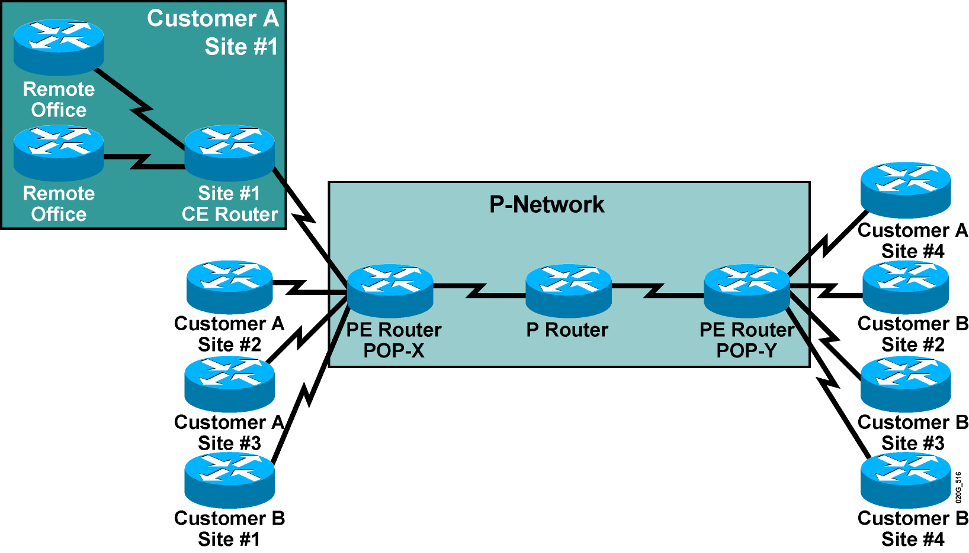
MPLS VPN Architecture (Cont.)
Terminology

Slide 9
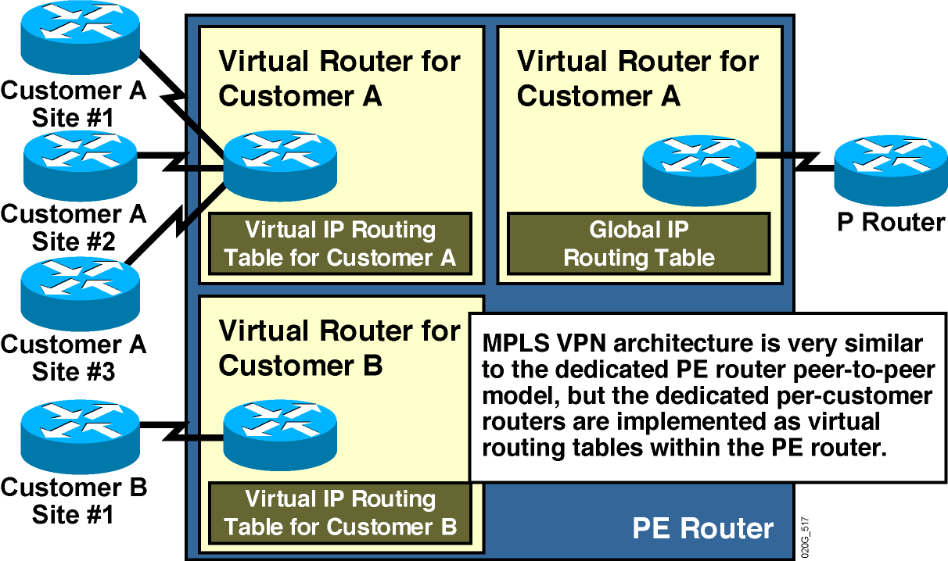
PE Router Architecture

Slide 10
Overlay model
• level 2 protocol, connection oriented (Frame Relay/ATM)
• site linked to provider’s network by VC (virtual circuit): Private Virtual Circuit
• PVC switched in provider’s network for connectivity with other sites
• routing topology invisible for provider
• complexity at user’s side
• problem with scalability
• traffic matrix updated
• PVC mesh to be updated
• routers reconfiguration in case of topology changes

Slide 11
Peer model
Characteristics:
Diverse routing protocols for users networks and provider network
User routers maintain routing adjacency with provider’s routers
Complexity shared between user and backbone
problem: private addresses not allowed

Slide 12
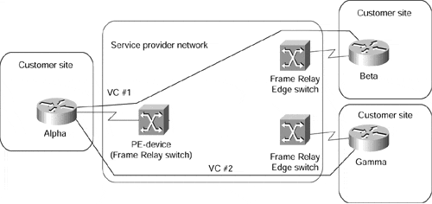

Slide 13
MPLS VPN Architecture
An MPLS VPN combines the best features of an overlay VPN and a peer-to-peer VPN:
  PE routers participate in customer routing, guaranteeing optimum routing between sites and easy provisioning.
  PE routers carry a separate set of routes for each customer (similar to the dedicated PE router approach).
  Customers can use overlapping addresses.
  PE routers deal only with connected VPNs
  MPLS in backbone
  independent of technology

Slide 14
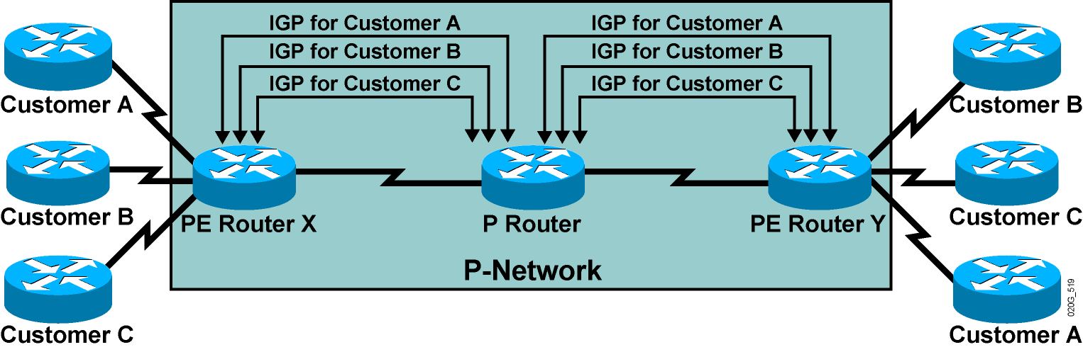
Propagation of Routing Information
Across the P-Network
Question: How will PE routers exchange customer routing information?
Answer #1: Run a dedicated Interior Gateway Protocol (IGP) for each customer
across the P-network.
This is the wrong answer for the following reasons:
    The solution does not scale.
    P routers carry all customer routes.

Slide 15
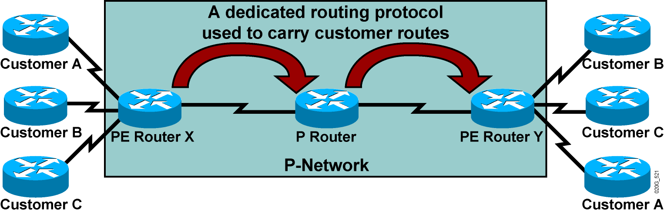
Propagation of Routing Information
Across the P-Network (Cont.)
Question: How will PE routers exchange customer routing information?
Answer #2: Run a single routing protocol that will carry all customer routes
inside the provider backbone.
Better answer, but still not good enough:
    P routers carry all customer routes.

Slide 16
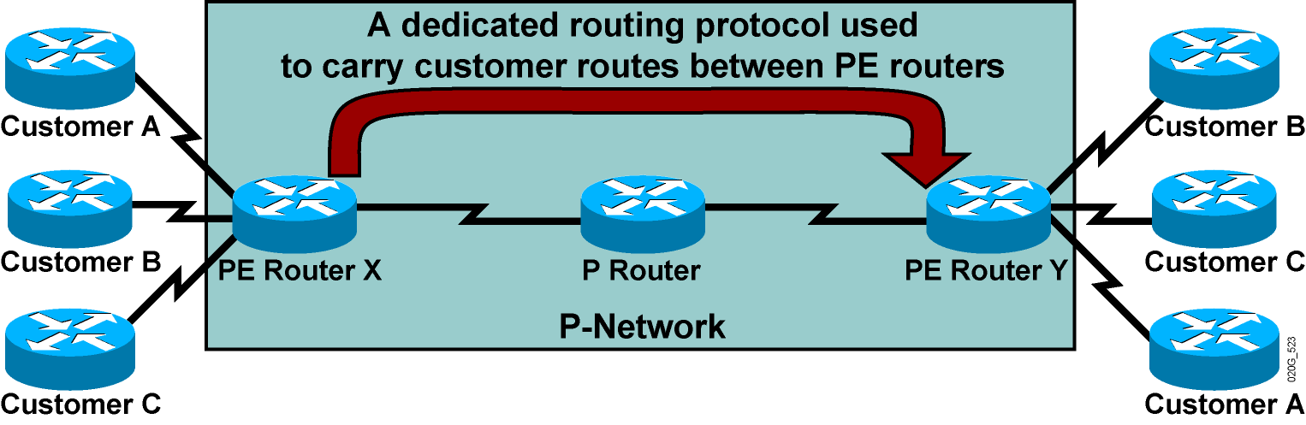
Propagation of Routing Information
Across the P-Network (Cont.)
Question: How will PE routers exchange customer routing information?
Answer #3: Run a single routing protocol that will carry all customer routes between PE routers. Use MPLS labels to exchange packets
between PE routers.
The best answer:
  P routers do not carry customer routes; the solution is scalable.

Slide 17
Propagation Routing Information
Across the P-Network (Cont.)
Question: Which protocol can be used to carry customer routes between
PE routers?
Answer: The number of customer routes can be very large. BGP is the only
routing protocol that can scale to a very large number of routes.
Conclusion:
BGP is used to exchange customer routes directly between PE routers.

Slide 18
Propagation of Routing Information
Across the P-Network (Cont.)
Question: How will information about the overlapping subnets of two customers be propagated via a single routing protocol?
Answer: Extend the customer addresses to make them unique.

Slide 19
Route Distinguishers
12 Bytes
100:1
10.10.10.0
RD
+ IPv4
VPNv4 Address
  The 64-bit route distinguisher (RD) is prepended to an IPv4 address to make it globally unique.
  The resulting address is a VPNv4 address.
  VPNv4 addresses are exchanged between PE routers via BGP.
    BGP that supports address families other than IPv4 addresses is called Multiprotocol BGP (MP-BGP).

Slide 20
Route Distinguishers (Cont.)
Route Distinguisher Format
Autonomous System
VPN Identifier
IP Address
VPN Identifier
8 Bytes
Service Providers can use their BGP AS along with VPN customer identifier
Service Provider who do not have BGP AS, can use an IP address

Slide 21
Route Distinguishers (Cont.)
100:2
10.10.10.0
100:1
10.10.10.0
VPNv4 Addresses
MP-iBGP update
Customer A has RD of 100:1
Customer B has RD of 100:2
Route Distinguisher keeps Customer A’s update unique from Customer B in the MP-iBGP update, although they use the same IP address

Slide 22
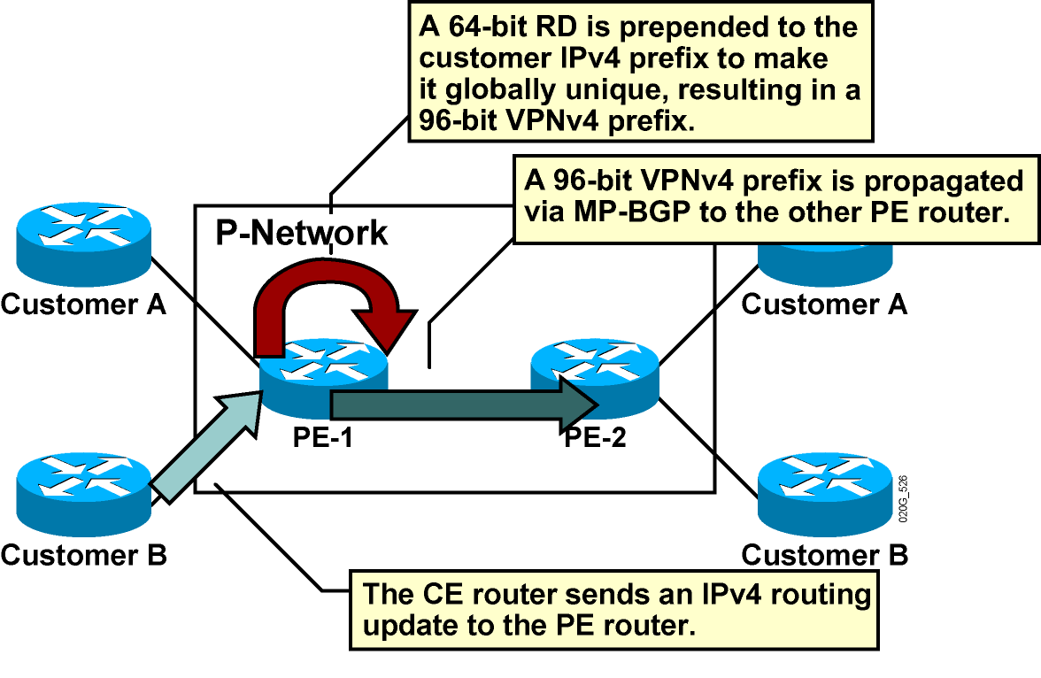
Route Distinguishers (Cont.)

Slide 23
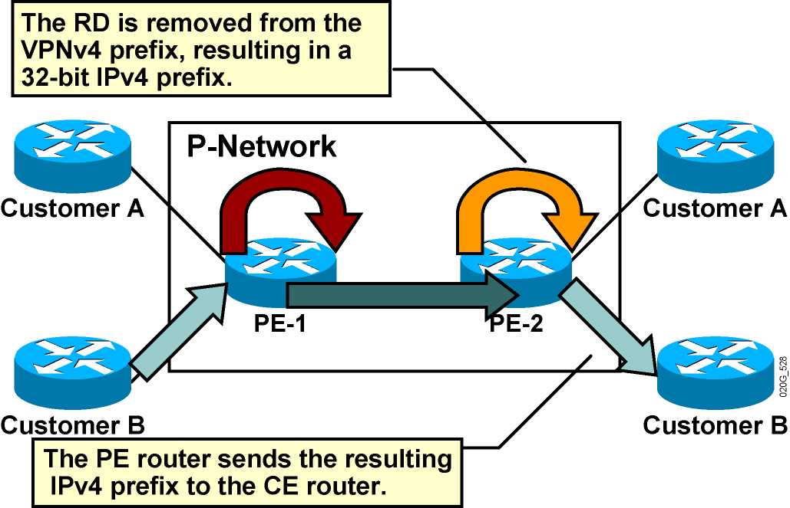
Route Distinguishers (Cont.)

Slide 24
Route Distinguishers (Cont.)
Usage in an MPLS VPN
  The RD has no special meaning.
  Used only to make potentially overlapping IPv4 addresses globally unique.
  The RD could serve as a VPN identifier, but this design could not support all topologies required by the customers.

Slide 25
Route Targets
Why Are They Needed?
  Some sites have to participate in more than one VPN.
  The RD cannot identify participation in more than one VPN.
  RTs were introduced in the MPLS VPN architecture to support complex VPN topologies.
    A different method is needed in which a set of identifiers can be attached to a route.

Slide 26
Route Targets (Cont.)
What Are They?
100:2
10.10.10.0
Customer B: 2
VoIP VPN: 2
VPNv4 update
Route-Targets
MP-iBGP update
  RTs are additional attributes attached to VPNv4 BGP routes to indicate VPN membership.
  Format is same as Route Distinguisher
  Extended BGP communities are used to encode these attributes.
    Extended communities carry the meaning of the attribute together with its value.
  Any number of RTs can be attached to a single route.

Slide 27
Route Targets (Cont.)
How Do They Work?
  Export RTs:
    Identifying VPN membership
    Appended to the customer route when it is converted into a VPNv4 route
  Import RTs:
    Associated with each virtual routing table
    Select routes to be inserted into the virtual routing table

Slide 28
Virtual Private Networks Redefined
With the introduction of complex VPN topologies, VPNs have had to be redefined:
  A VPN is a collection of sites sharing common routing information.
  A site can be part of different VPNs.
  A VPN can be seen as a community of interest (closed user group, or CUG).
  Complex VPN topologies are supported by multiple virtual routing tables on the PE routers.

Slide 29
Impact of Complex VPN Topologies on Virtual Routing Tables
  A virtual routing table in a PE router can be used only for sites with identical connectivity requirements.
  Complex VPN topologies require more than one virtual routing table per VPN.
  As each virtual routing table requires a distinct RD value, the number of RDs in the MPLS VPN network increases.

Slide 30
Important points to note for RT and RD
  Route Distinguishers (RD) are only used to make ipv4 VPN addresses unique when advertising them over MP-iBGP, by making them vpnv4 prefixes
  We can have one RD per vrf
  Only one vrf can be assigned to an interface
  Route Targets (RT) are used for VPN membership, so that complex scenarios can be addressed
  VPN is the set of rules for customer connectivity and can be very complex
  A VPN may have several RTs

Slide 32
Distribuirea informatiei de rutare:
Distribuire constransa a informatiei de rutare ( conectivitatea site-uri
determinata de distribuirea informatie rutare)
Step 1 : de la site (de la CE asociat) la service provider (la interfata PE
corespunzatoare)
Prin RIP, static routing, BGP, sau OSPF
Step 2 : pentru PE ingress: export informatie de rutare (bazata pe IP) la
protocolul MP-iBGP rulat in retea provider (intre rutere PE), prin formare
adresa VPN-IP;
Step 3 : transmisie in cadrul/intre domenii providerilor (intre PEs) – de
obicei in backbone (aici MPLS backbone)
Step 4 : informatia de rutare (VPN-IP) importata de la MP-iBGP provider si
transmisa catre egress PE (adresa IP folosita in tabela de inaintare (VRF)
corespunzatoare)
Step 5 : de la provider (PE) la site (CE)
e.g., via RIP, static routing, BGP, sau OSPF

Slide 33
MP-BGP Extensions
BGP has been extended in the form in Multi-protocol (MP)-BGP to carry routes from multiple “address families” in the form of VPNv4-AF
VPNv4-AF is a 12-byte field of the form:
  Route-Distinguisher [RD] 8-byte
  IPv4-Address 4-byte
Route-Target Attribute
Label value
8 Bytes
4 Bytes
8 Bytes
3 Bytes
1:1
10.1.1.0
2:2
50
RD
IPv4
Route-Target
Label
VPNv4
MP-IBGP update with RD, RT, and label

Slide 34
MPLS VPN Routing Requirements
  CE routers have to run standard IP routing software.
  PE routers have to support MPLS VPN services and Internet routing.
  P routers have no VPN routes.

Slide 35
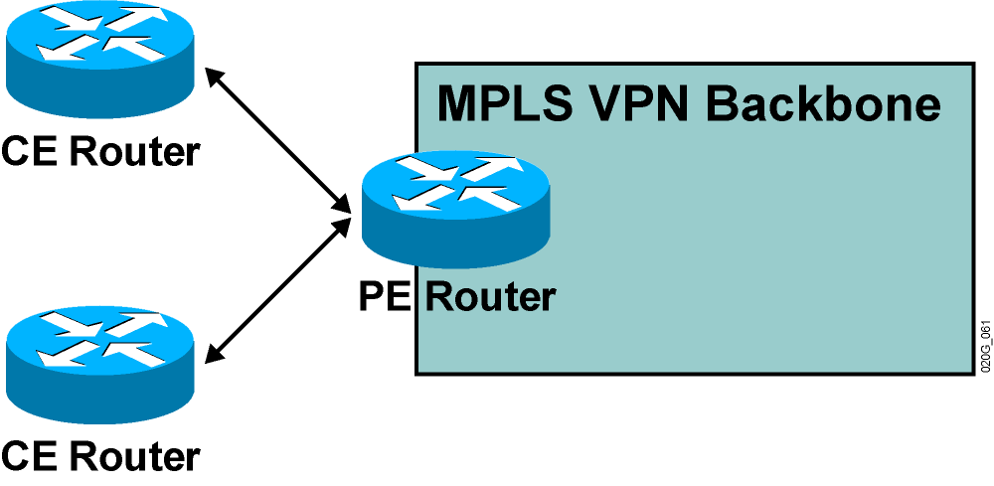
MPLS VPN Routing
CE Router Perspective
  The CE routers run standard IP routing software and exchange routing updates with the PE router.
    PE-CE protocols can be EBGP, OSPF, RIPv2, EIGRP, and static routes.
  The PE router appears as another router in the C-network.

Slide 36
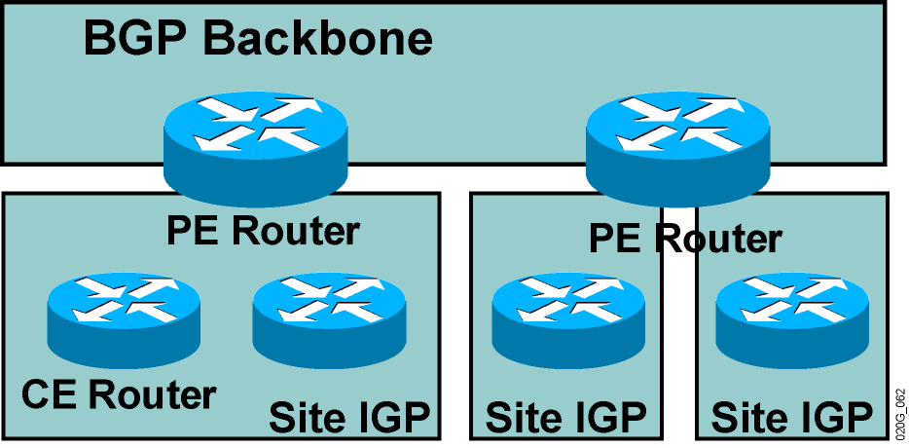
MPLS VPN Routing (cont.)
Overall Customer Perspective
  To the customer, the PE routers appear as core routers connected via a BGP backbone.
  The usual BGP and IGP design rules apply.
  The P routers are hidden from the customer.

Slide 37
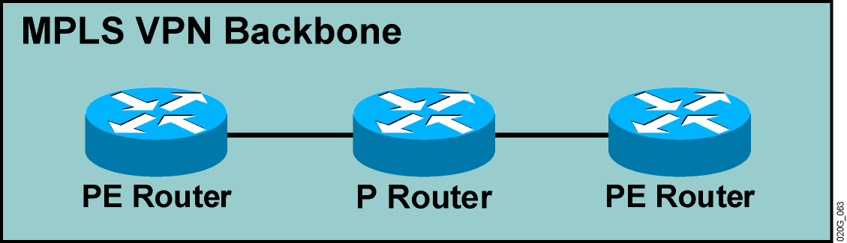
MPLS VPN Routing (Cont.)
P Router Perspective
  P routers do not participate in MPLS VPN routing and do not carry VPN routes.
  P routers run backbone IGP with the PE routers and exchange information about global subnets (core links and loopbacks).

Slide 38
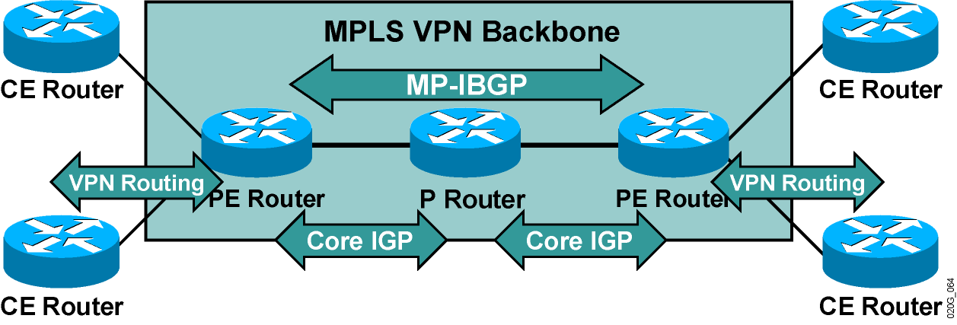
MPLS VPN Routing (Cont.)
PE Router Perspective
PE routers:
  Exchange VPN routes with CE routers via per-VPN routing protocols
  Exchange core routes with P routers and PE routers via core IGP
  Exchange VPNv4 routes with other PE routers via MP-IBGP sessions

Slide 39
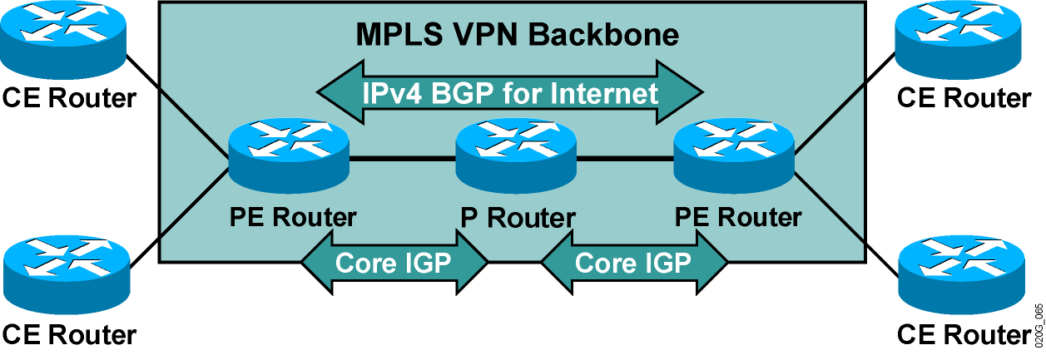
Support for Existing Internet Routing
PE routers can run standard IPv4 BGP in the global routing table:
  PE routers exchange Internet routes with other PE routers.
  CE routers do not participate in Internet routing.
  P routers do not need to participate in Internet routing.

Slide 40
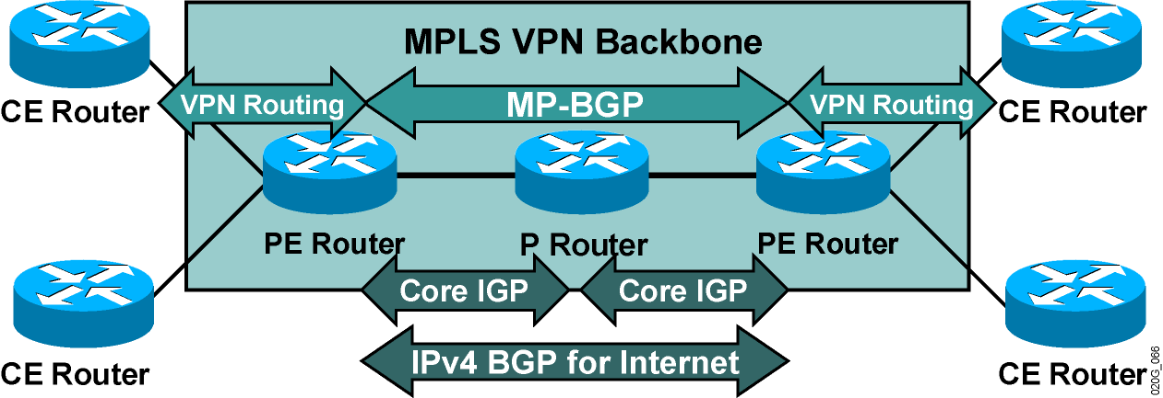
Routing Tables on PE Routers
PE routers contain a number of routing tables:
  Global routing table, which contains core routes (filled with core IGP) and Internet routes (filled with IPv4 BGP)
  VRF tables for sets of sites with identical routing requirements
  VRFs filled with information from CE routers and MP-BGP information from other PE routers

Slide 41
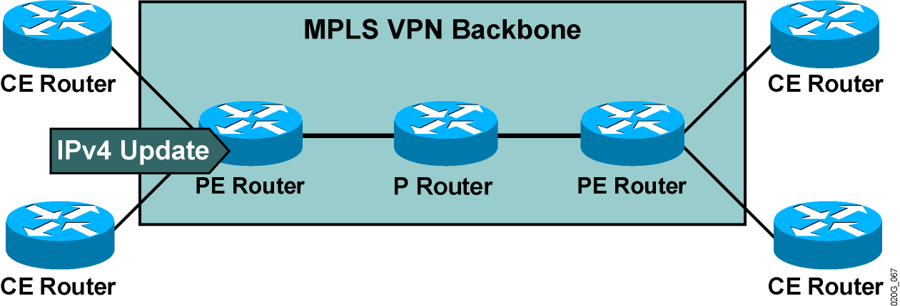
End-to-End Routing Update Flow
PE routers receive IPv4 routing updates from CE routers and install them in the appropriate VRF table.

Slide 42
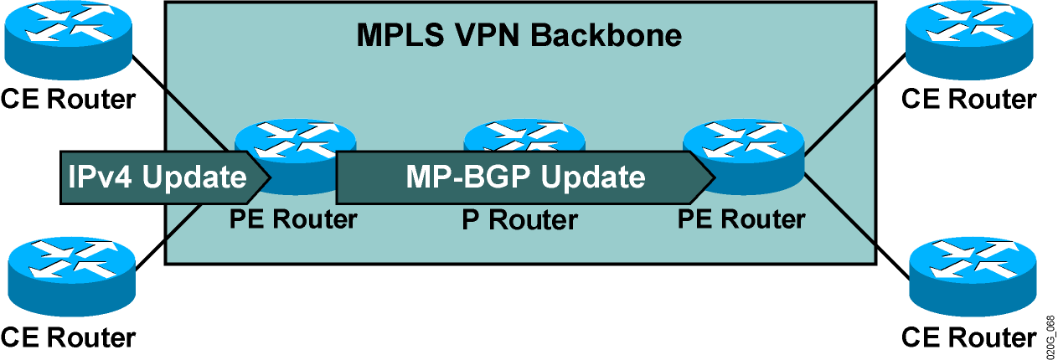
End-to-End Routing Update Flow (Cont.)
PE routers export VPN routes from VRF tables into
MP-BGP and propagate them as VPNv4 routes to other
PE routers.

Slide 43
End-to-End Routing Update Flow (Cont.)
MP-BGP Update
An MP-BGP update contains the following:
  VPNv4 address
  Extended communities
  (route targets, optionally SOO)
  Label used for VPN packet forwarding
  Any other BGP attribute (for example, AS path, local preference, MED, standard community)

Slide 44
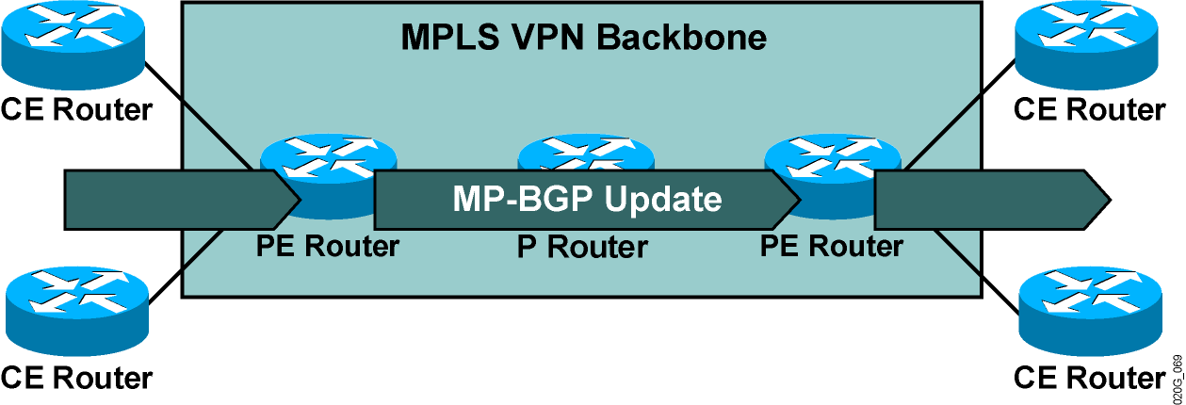
End-to-End Routing Update Flow (Cont.)
Receiving PE router imports incoming VPNv4 routes into the appropriate VRF based on route targets attached to the routes.
Routes installed in VRF are propagated to CE routers.

Slide 45
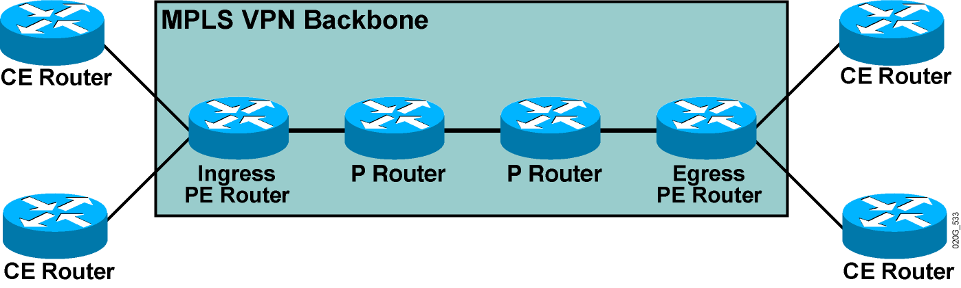
VPN Packet Forwarding Across an MPLS VPN Backbone
Question: How will the PE routers forward the VPN packets across the
MPLS VPN backbone?
Answer #1: They will label the VPN packets with an LDP label for the egress
PE router and forward the labeled packets across the MPLS backbone.

Slide 46
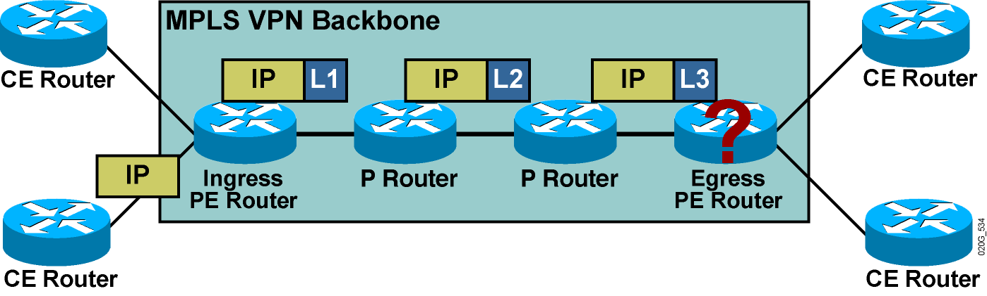
VPN Packet Forwarding Across an MPLS VPN Backbone
Question: How will the PE routers forward the VPN packets across the
MPLS VPN backbone?
Answer #1: They will label the VPN packets with an LDP label for the egress
PE router and forward the labeled packets across the MPLS backbone.
Results:
The P routers perform the label switching, and the packet reaches the
egress PE router.
However, the egress PE router does not know which VRF to use for packet
switching, so the packet is dropped.
How about using a label stack?

Slide 47
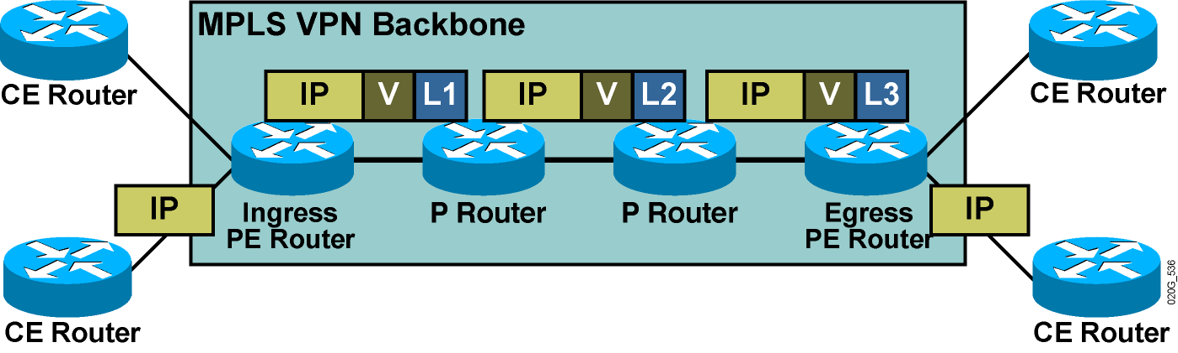
VPN Packet Forwarding Across an MPLS VPN Backbone (Cont.)
Question: How will the PE routers forward the VPN packets across the
MPLS VPN backbone?
Answer #2: They will label the VPN packets with a label stack, using the LDP label for
the egress PE router as the top label, and the VPN label assigned by the
egress PE router as the second label in the stack.
Result:
The P routers perform label switching, and the packet reaches the egress
PE router.
The egress PE router performs a lookup on the VPN label and forwards the packet
toward the CE router.

Slide 48
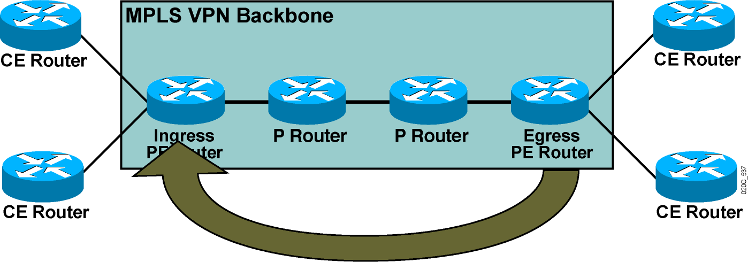
VPN Label Propagation
Question: How will the ingress PE router get the second label in the
label stack from the egress PE router?
Answer: Labels are propagated in MP-BGP VPNv4 routing updates.

Slide 49
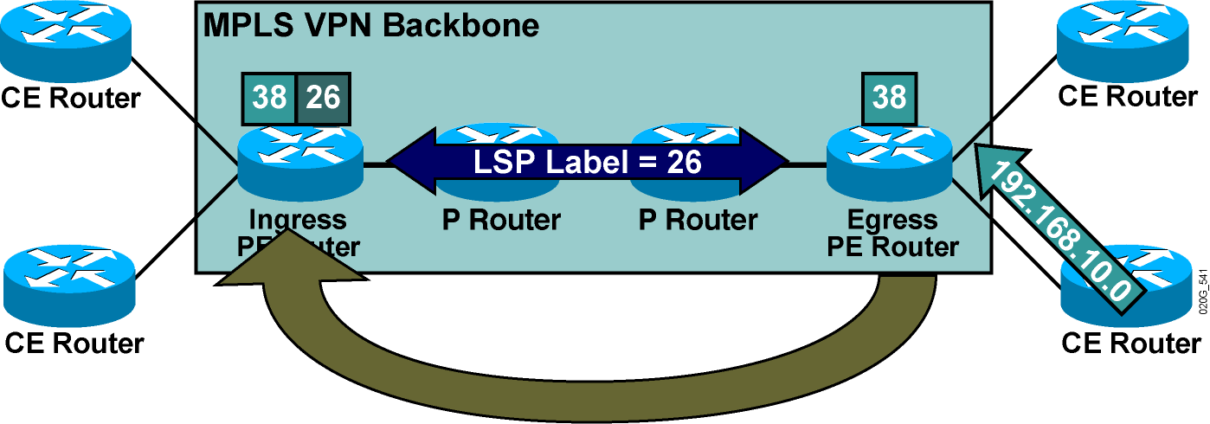
VPN Label Propagation (Cont.)
Step 1: A VPN label is assigned to every VPN route by the egress
PE router.
Step 2: The VPN label is advertised to all other PE routers in an MP-BGP
update.
Step 3: A label stack is built in the VRF table.

Slide 50
MPLS VPNs and Label Propagation
  The VPN label must be assigned by the BGP next hop.
  The BGP next hop should not be changed in the MP-IBGP update propagation.
  The PE router must be the BGP next hop.
  The label must be reoriginated if the next hop is changed.
    A new label is assigned every time that the MP-BGP update crosses the AS boundary where the next hop is changed.

Slide 51
MPLS VPN Label Stack
There are at least two labels when using MPLS-VPN
The first label is distributed by TDP/LDP
  Derived from an IGP route
  Corresponds to a PE address (VPN egress point)
  PE addresses are MP-BGP next-hops of VPN routes
The second label is distributed by MP-BGP
  Corresponds to the actual VPN route
  Identifies the PE outgoing interface or routing table
L2 Header
Label 1
Label 2
L3 Header
Data
Frame, e.g. HDLC, PPP, Ethernet

Slide 52
MPLS VPN Operation
CE
= RT?
CE
RD +
RD +
= RT?
VPN labels, RTs
PE
RR
PE
P
P
PE
RR
PE
RD +
RD +
RD +
CE
VPN labels, RTs
CE
Import routes into VRF if route-targets match (export = import)
Customer routes placed into separate VRF tables at each PE
IGP (OSPF,ISIS) used to establish reachability to destination networks.
Label Distribution Protocol establishes mappings to IGP addresses
CE-PE dynamic routing (or static) populate the VRF routing tables
MP-BGP between PE router to distribute routes between VPNs

Slide 53
MPLS VPN Forwarding Example
CE
CE
PE
PE
P
P
CE
CE
PE
PE
Swap IGP Label
(From LFIB)
POP IGP Label
(Pentultimate Hop)
Push VPN Label
(Red Route)
Push IGP Label
(Green PE Router)
Pop VPN Label
(Red Route)

Slide 54
Virtual Routing and Forwarding
A VRF is the routing and forwarding instance for a set of sites with identical connectivity requirements.
Data structures associated with a VRF:
  IP routing table
  Cisco Express Forwarding (CEF) forwarding table
  Set of rules and routing protocol parameters
  (routing protocol contexts)
  List of interfaces that use the VRF
Other information associated with a VRF:
  Route Distinguisher (RD)
  Set of import and export route targets

Slide 55
Provider Edge VRFs (PE VRFs)
Label Switching (MPLS) or Tunneling (L2TPv3)
IP Switching
MPLS/Tunnel Labels
and Route Targets
802.1q
VRF
VRF
VRF
Logical or Physical Int
(Layer 3)
VPN LSP/Tunnel
PE Router

Slide 56
VPN-Aware Routing Protocols
Routing context = routing protocol run in one VRF
  Supported by VPN-aware routing protocols:
    External BGP (EBGP), OSPF, RIP version 2 (RIPv2), EIGRP, IS-IS, Static routes
  Implemented as several instances of a single routing process (EBGP, RIPv2) or as several routing processes (OSPF)
  Independent per-instance router variables for each instance

Slide 57
VRF Routing Table
Contains routes that should be available to a particular set of sites
Analogous to standard Cisco IOS software routing table; supports same set of mechanisms
VPN interfaces (physical interface, subinterfaces, logical interfaces) assigned to VRFs
  Many interfaces per VRF
  Each interface assignable to only one VRF

Slide 58
MPLS Layer 3 VPNs
Notes:
58

